Slide 1


FPT SOFTWARE
Machine Learning Fundamentals
10/02/18

Slide 2
Supervised Learning
Lecture 2: Supervised Learning
Outline:
Regression and Classification
Inductive Learning
Decision Trees
Bayesian Learning
Neural Networks
Model Ensembles
Learning Theory
Support Vector Machine
Exercise

Slide 3
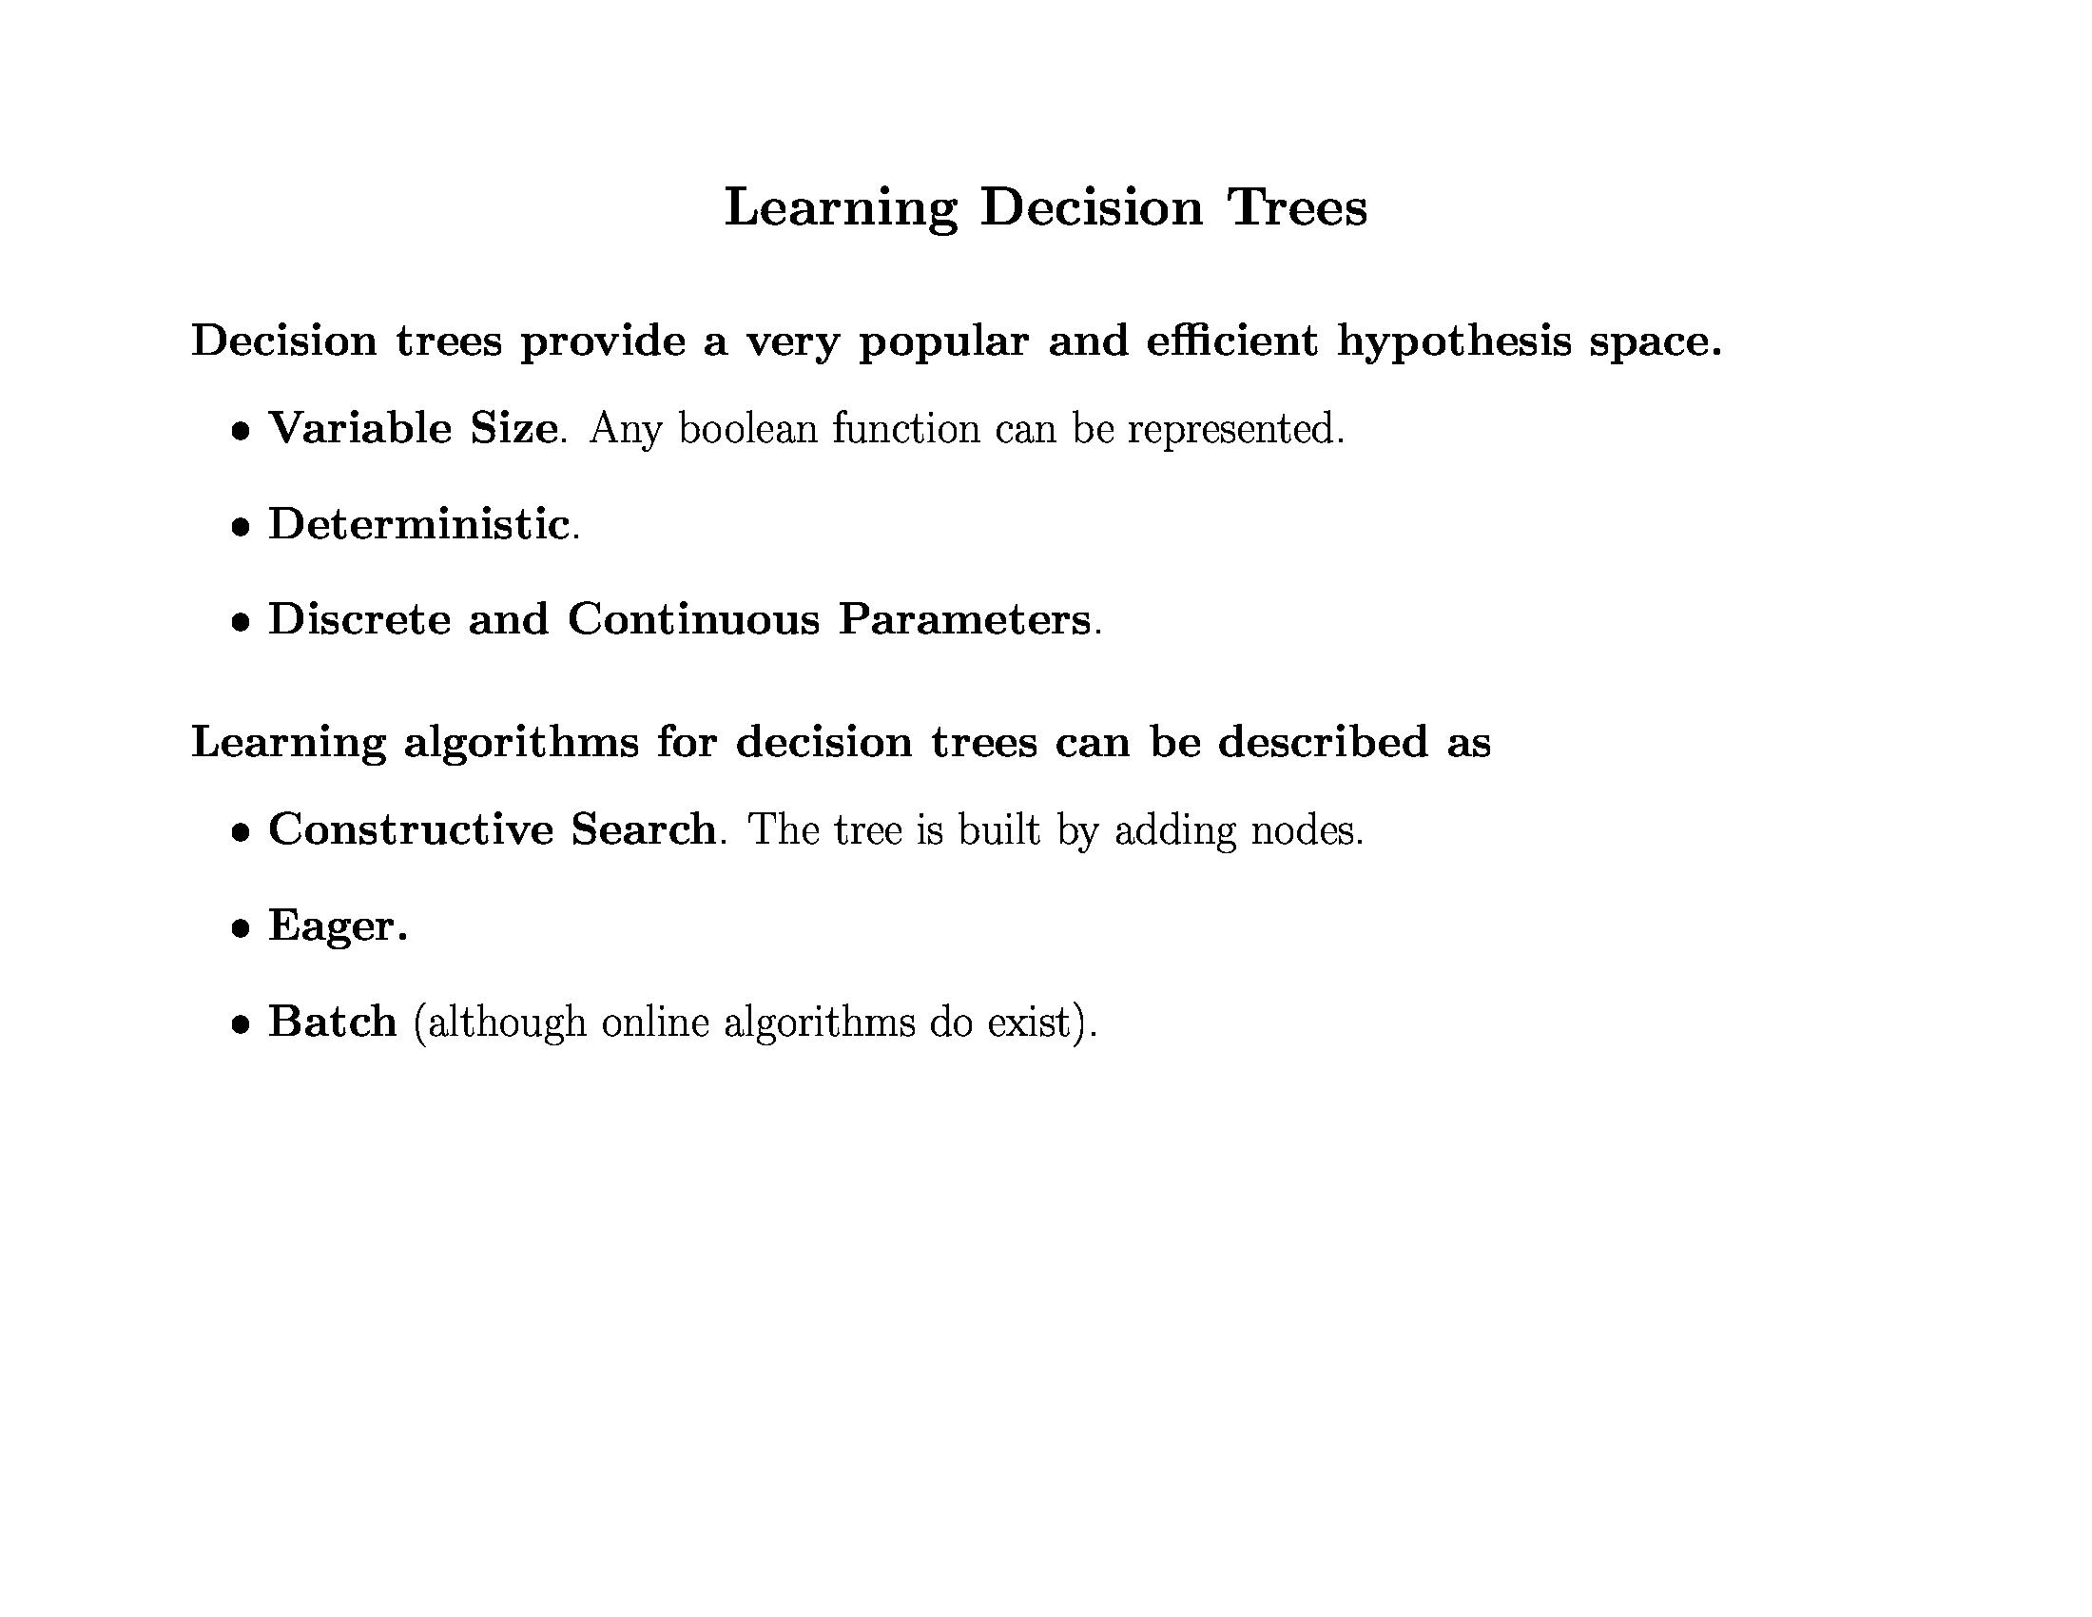
Decision Trees

Slide 4
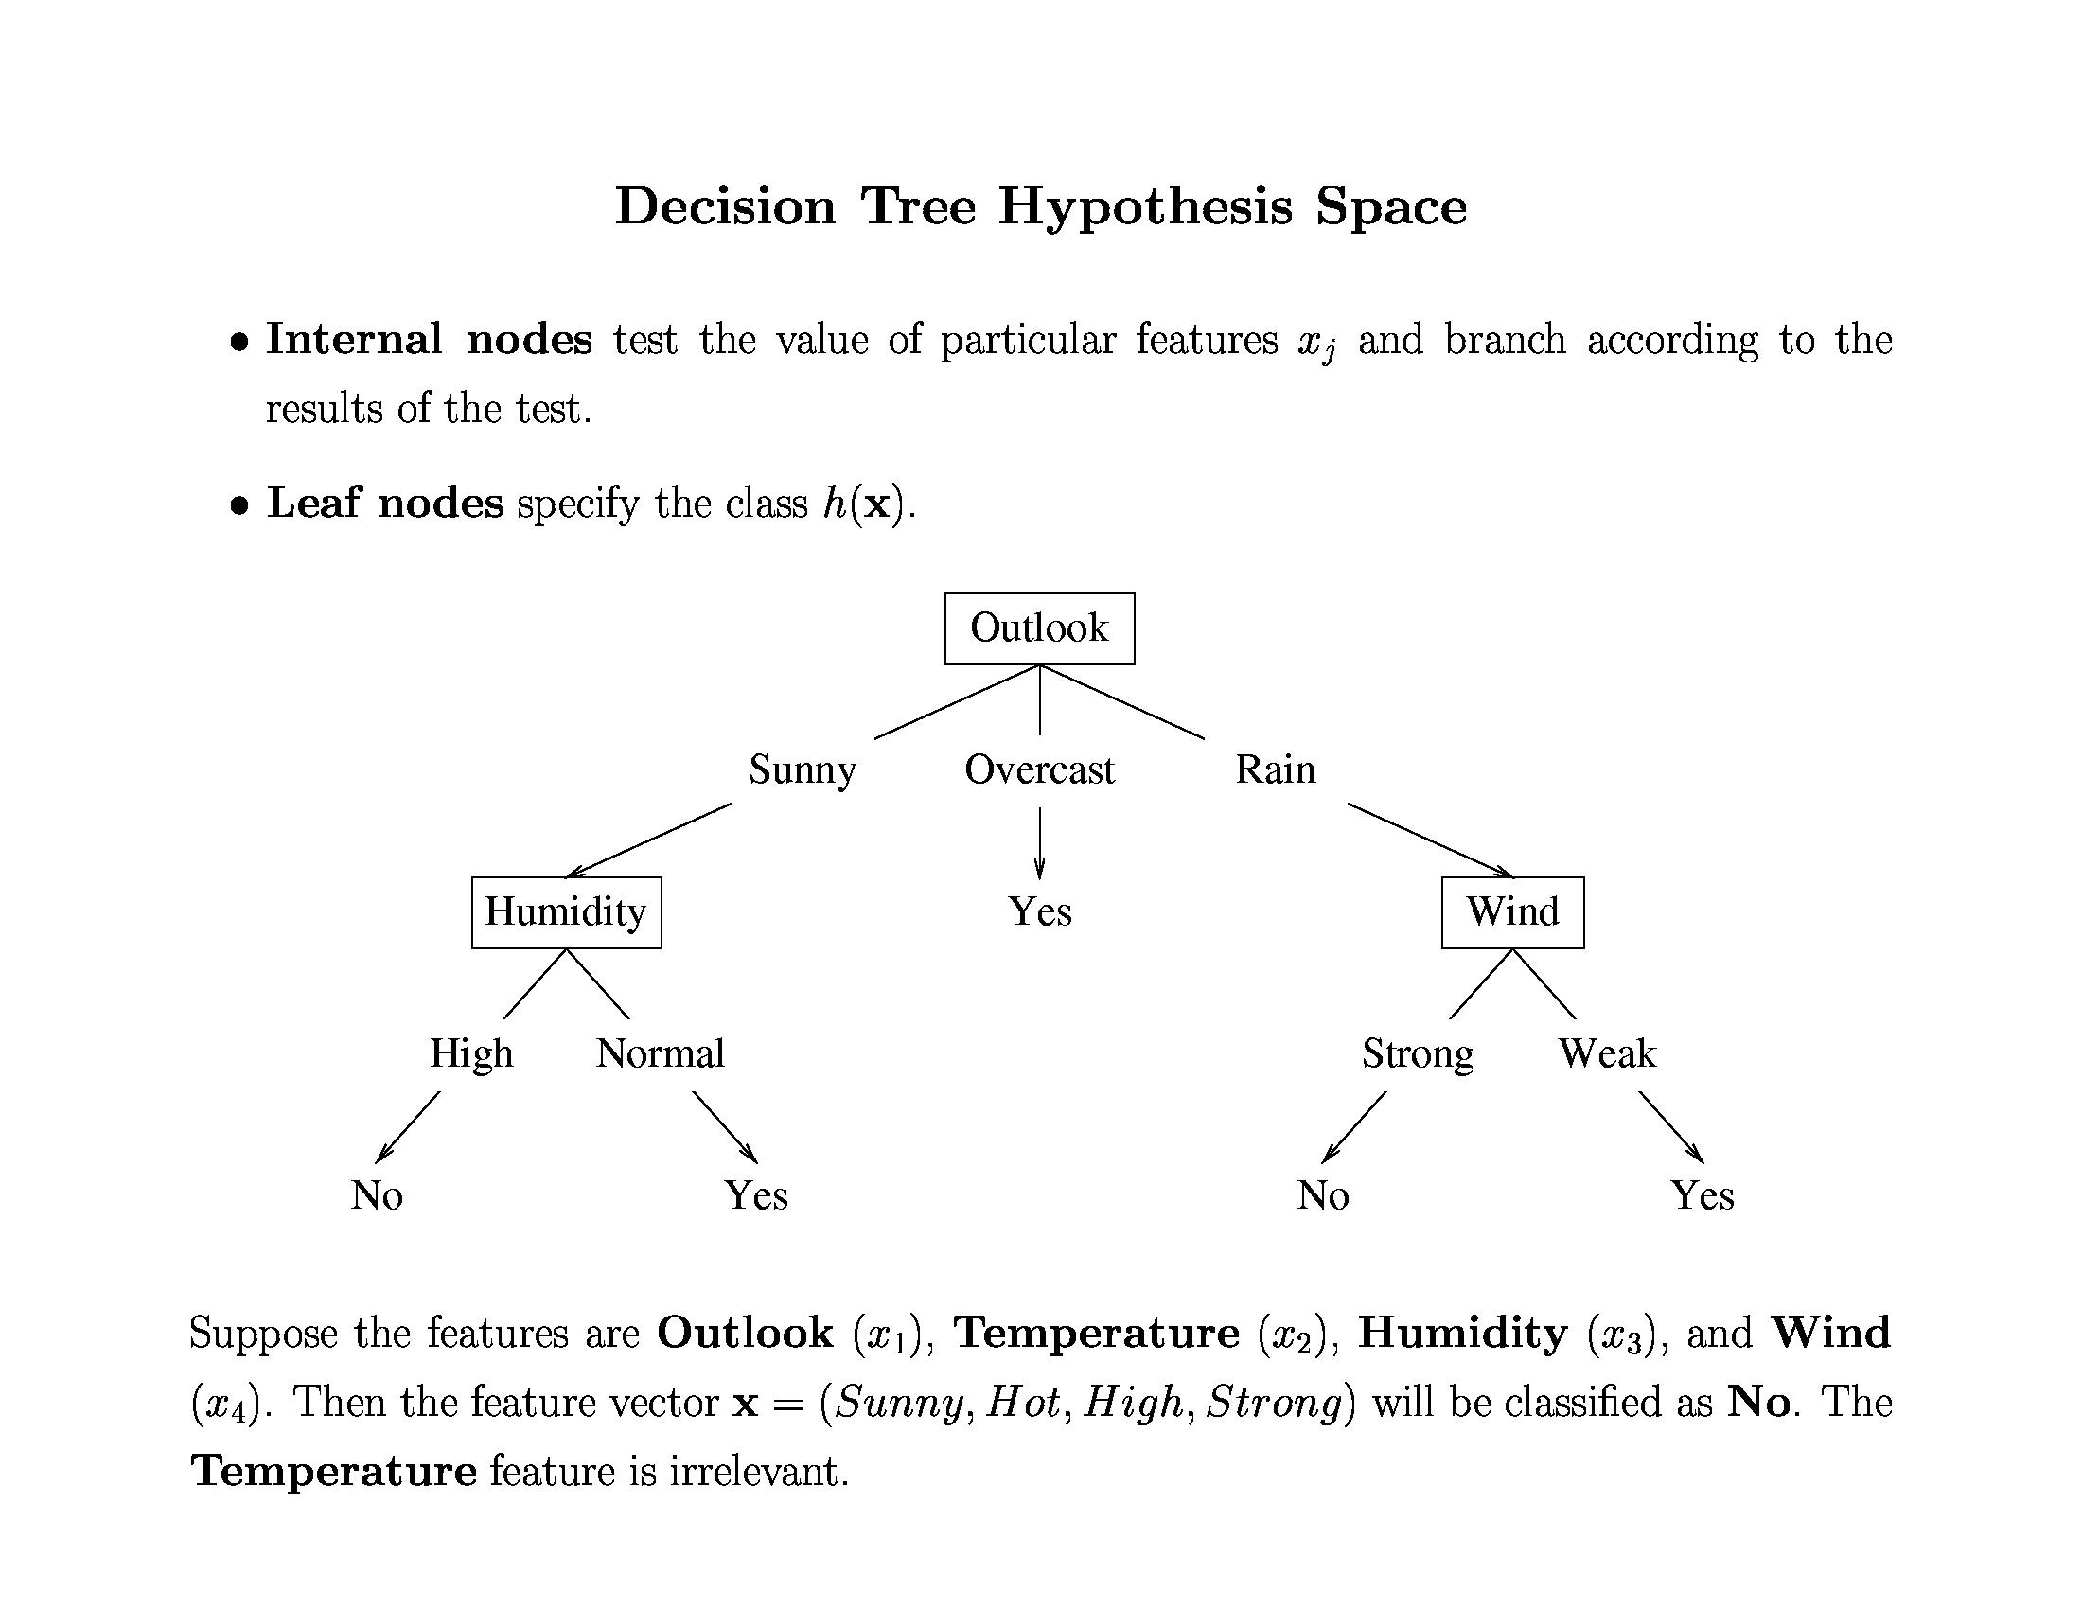
Decision Trees

Slide 5
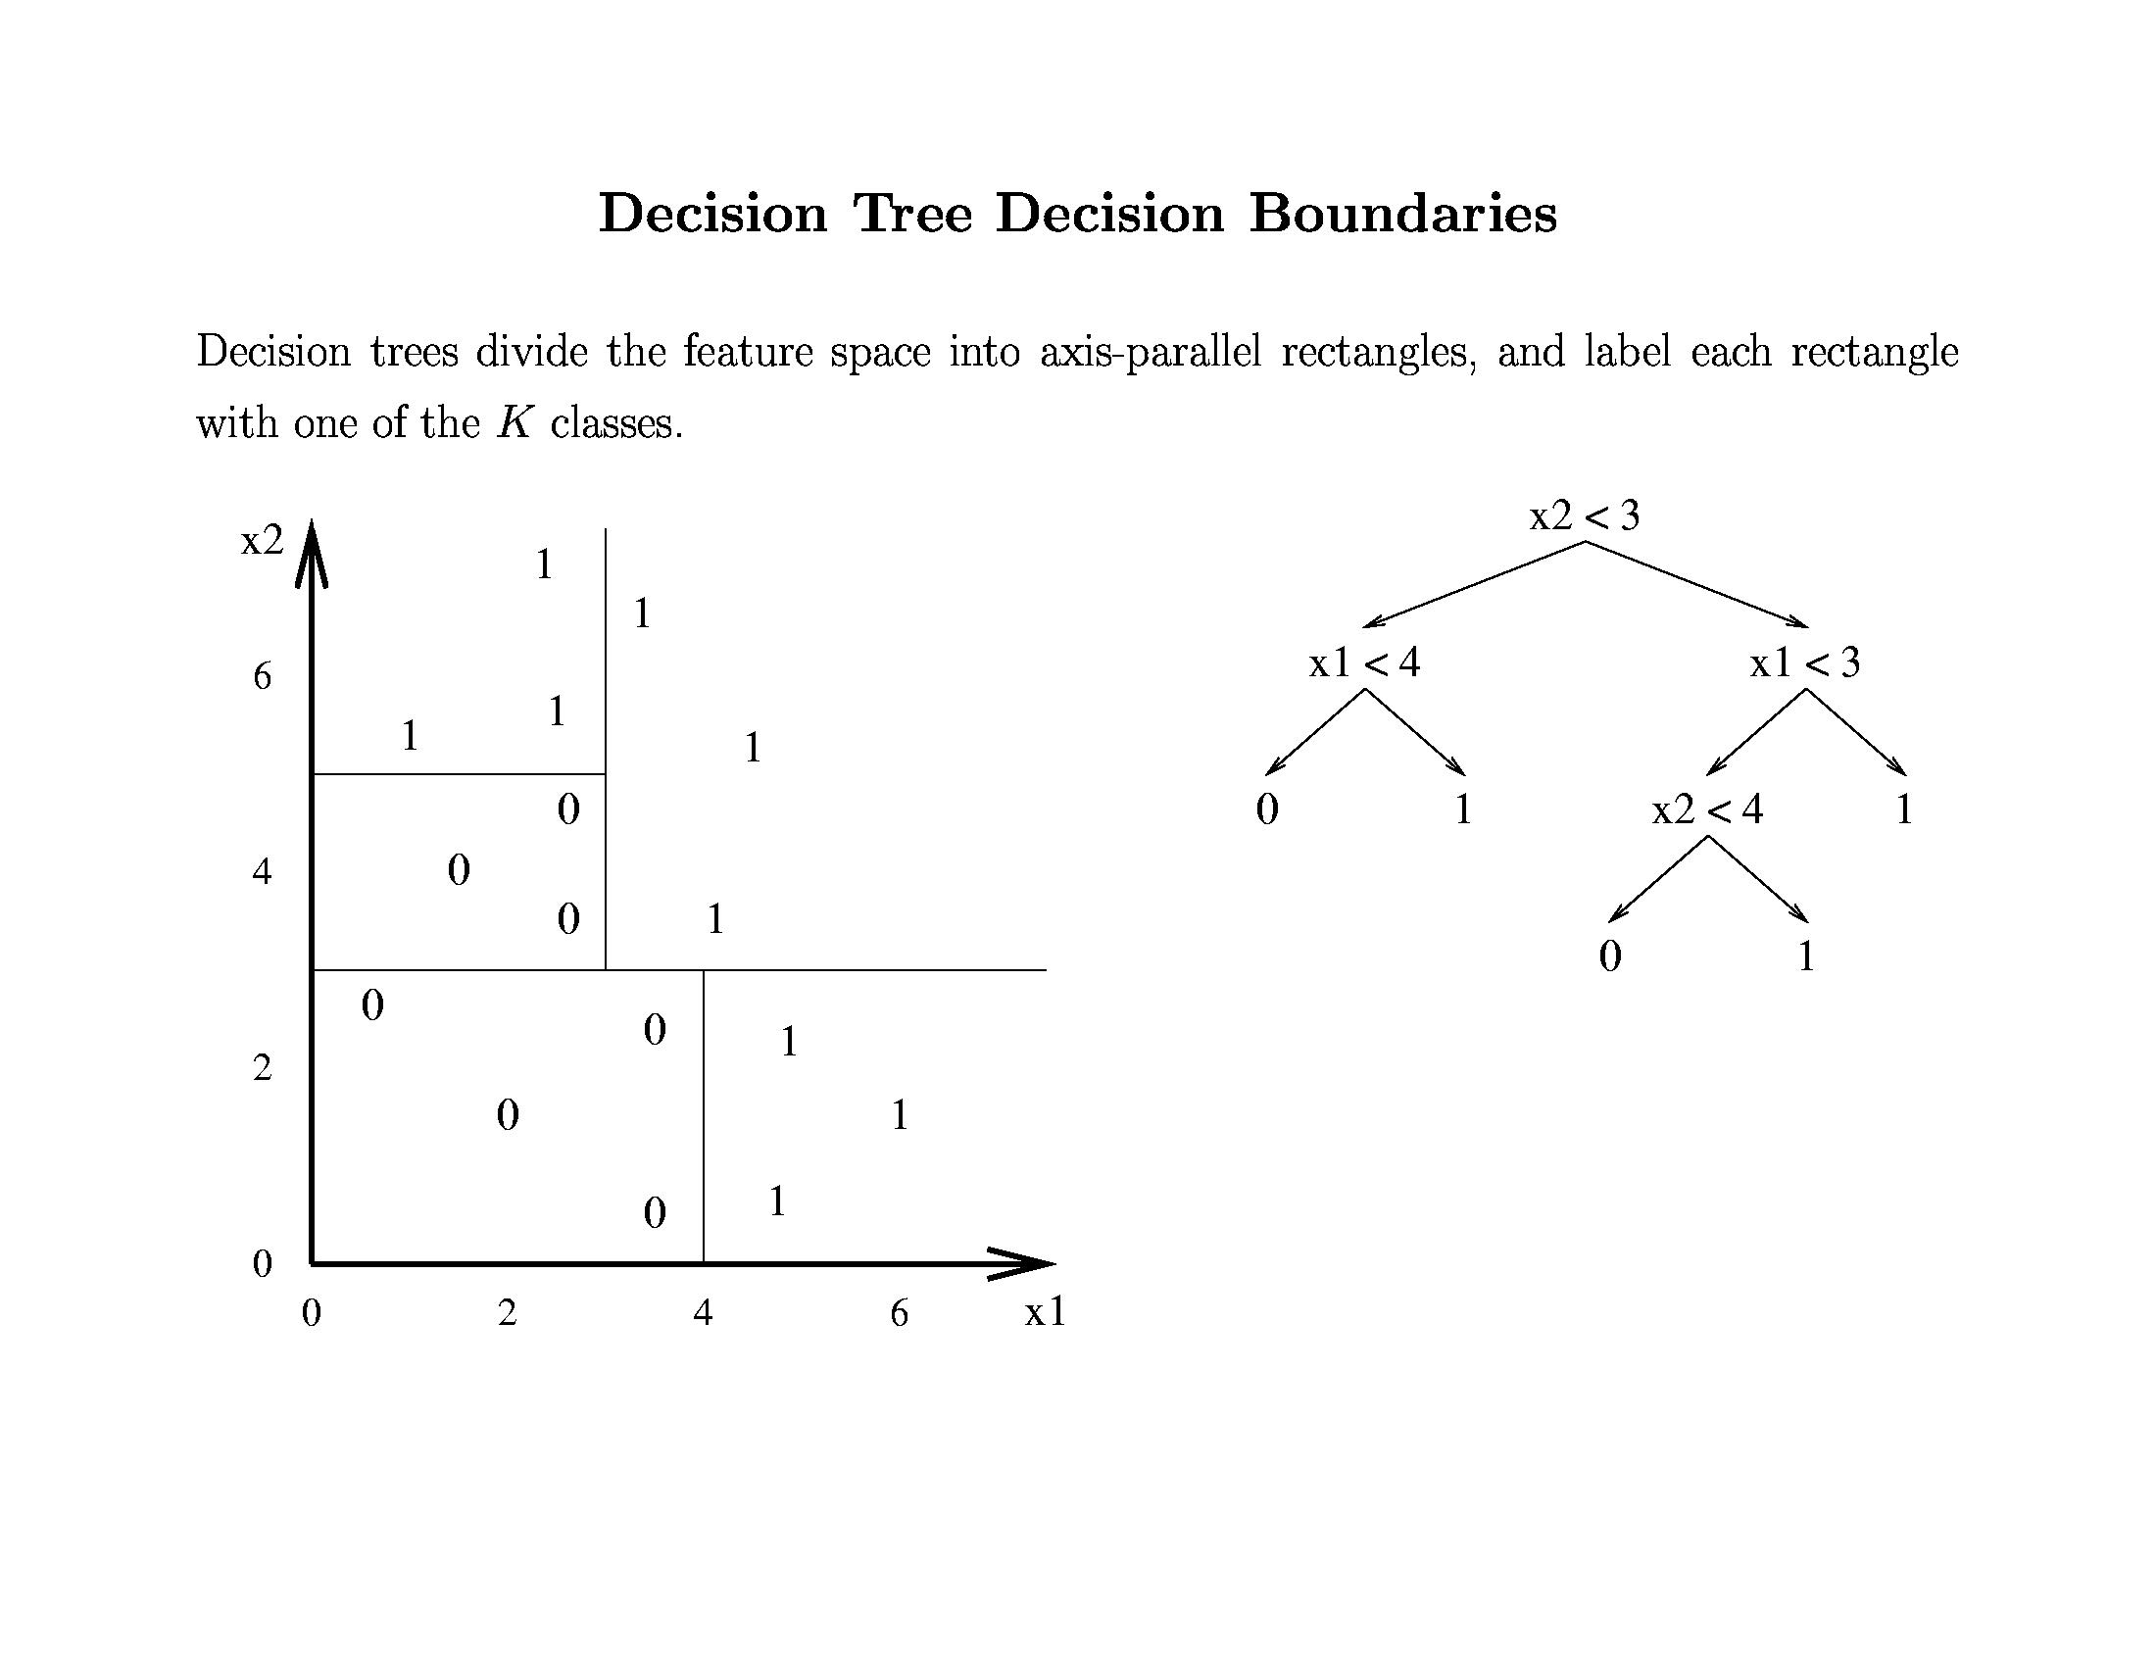
Decision Trees

Slide 6
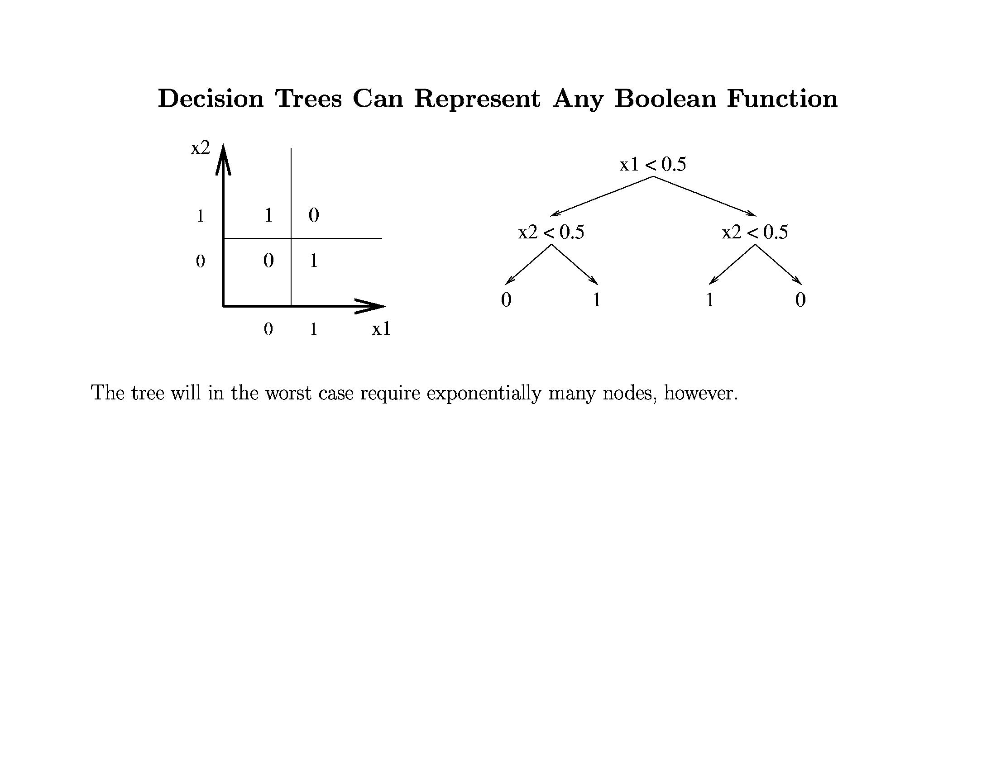
Decision Trees

Slide 7
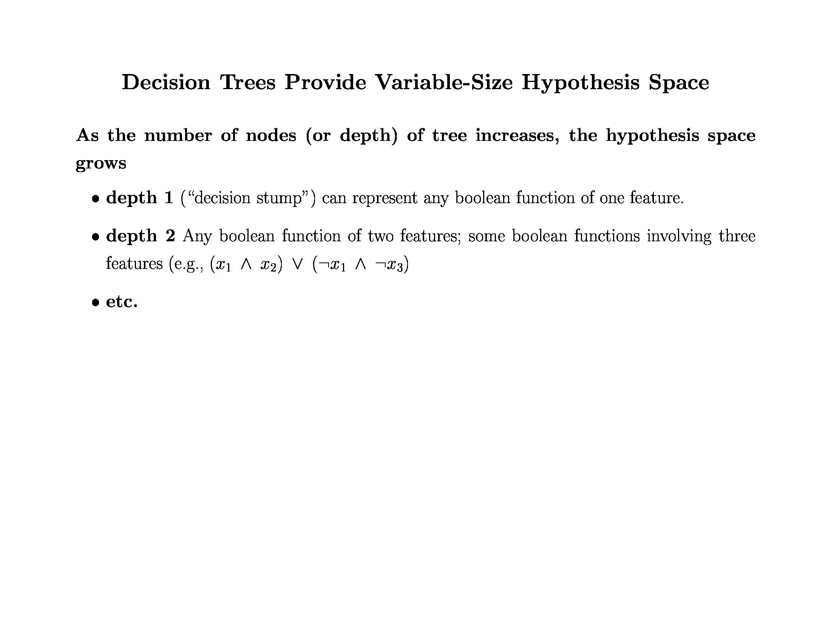
Decision Trees

Slide 8
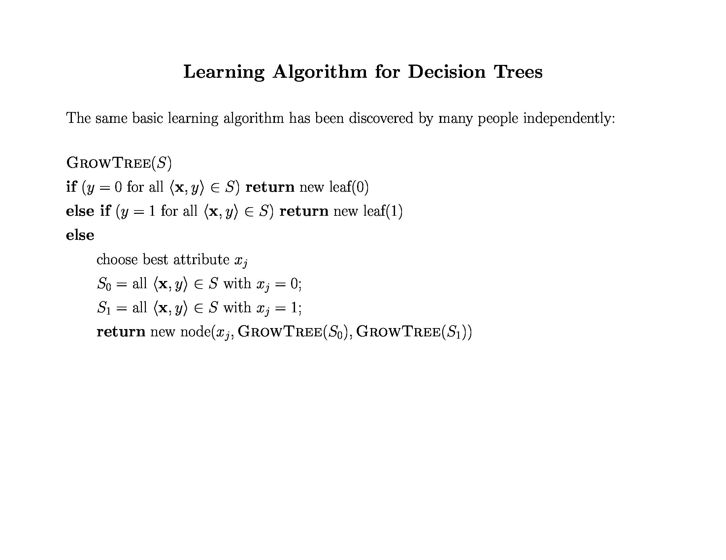
Decision Trees

Slide 9
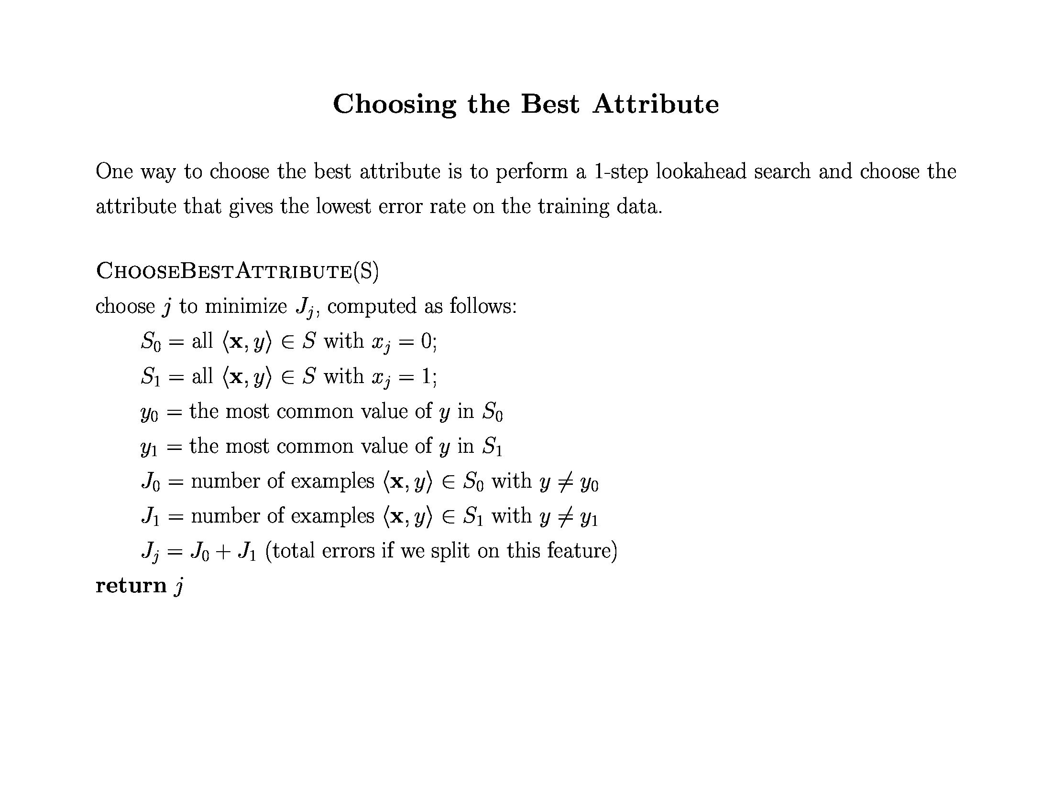
Decision Trees

Slide 10
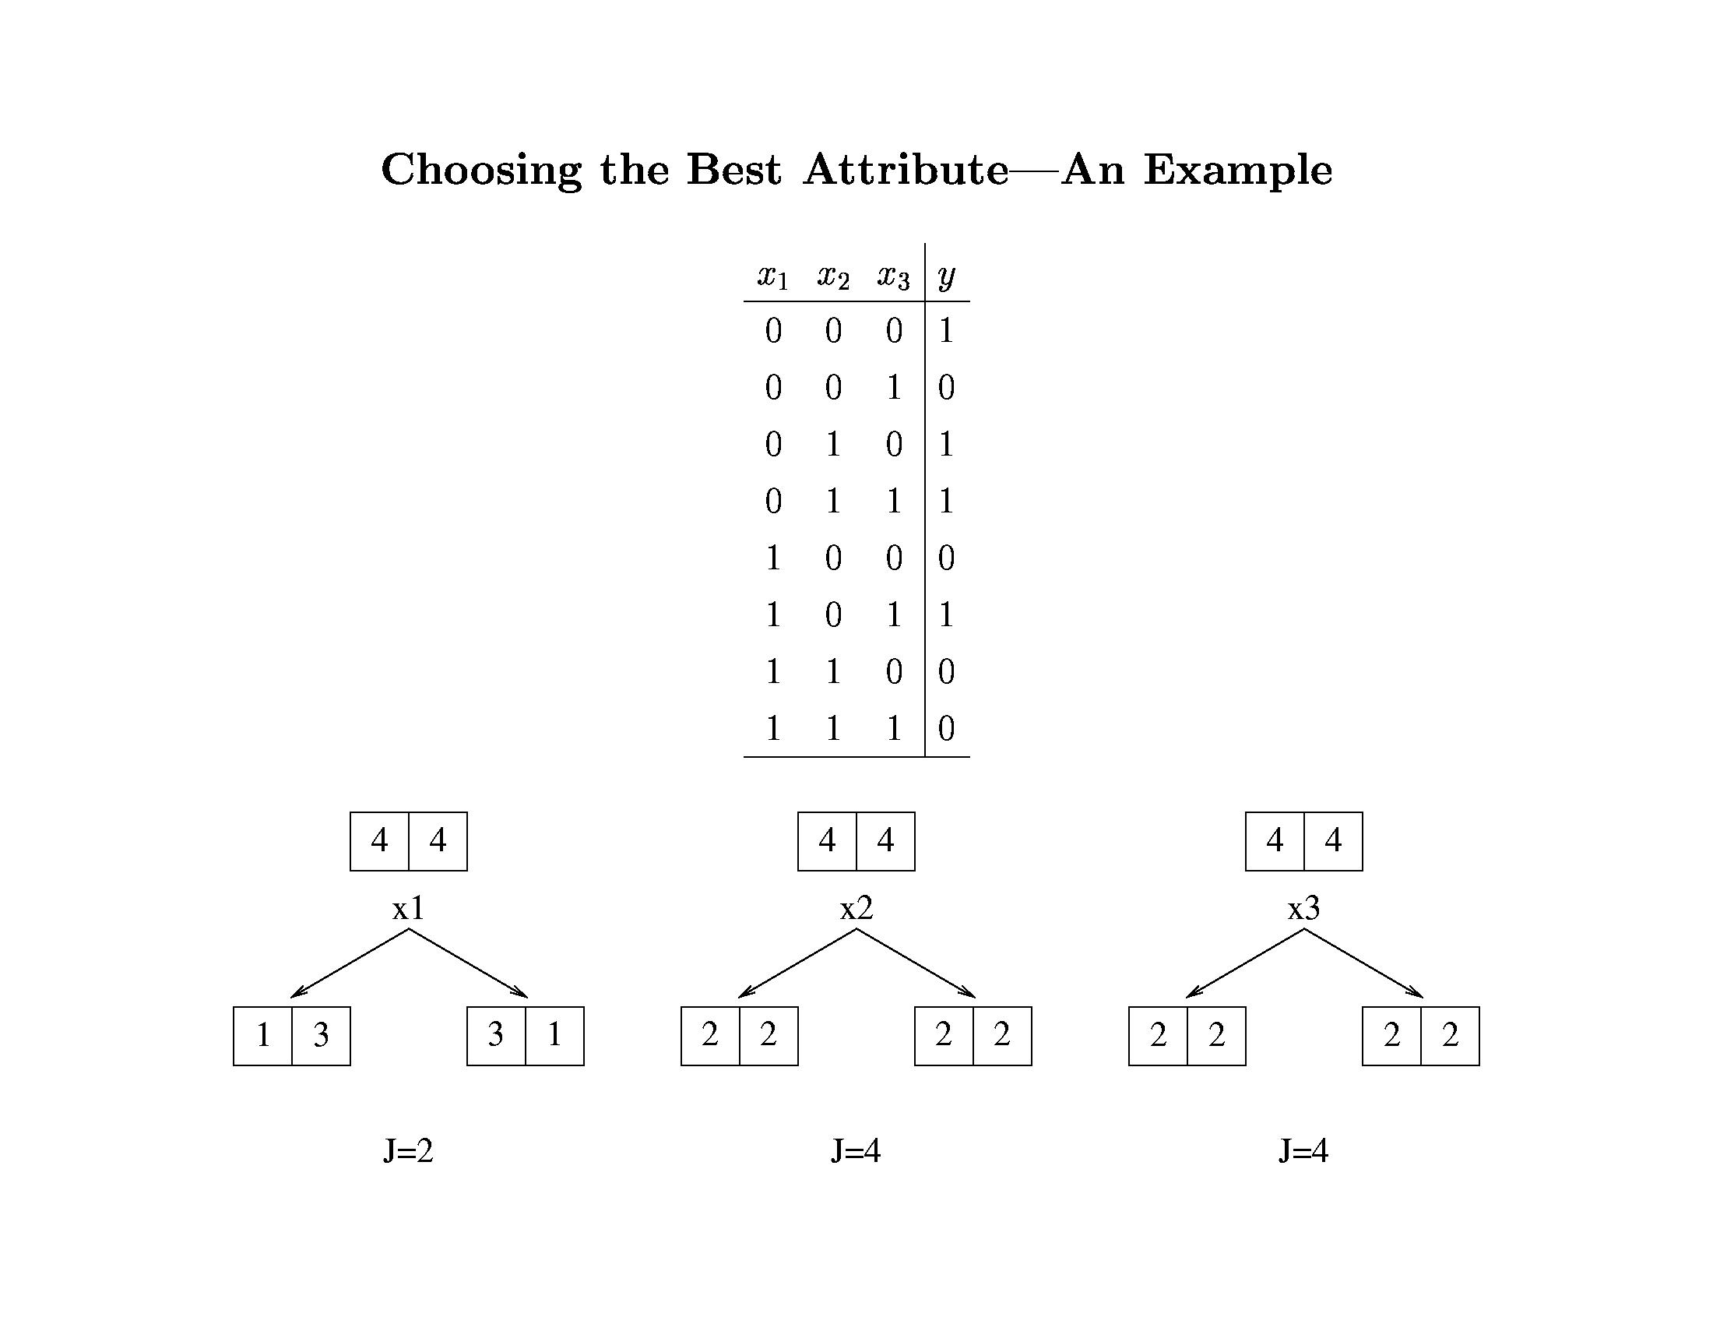
Decision Trees

Slide 11
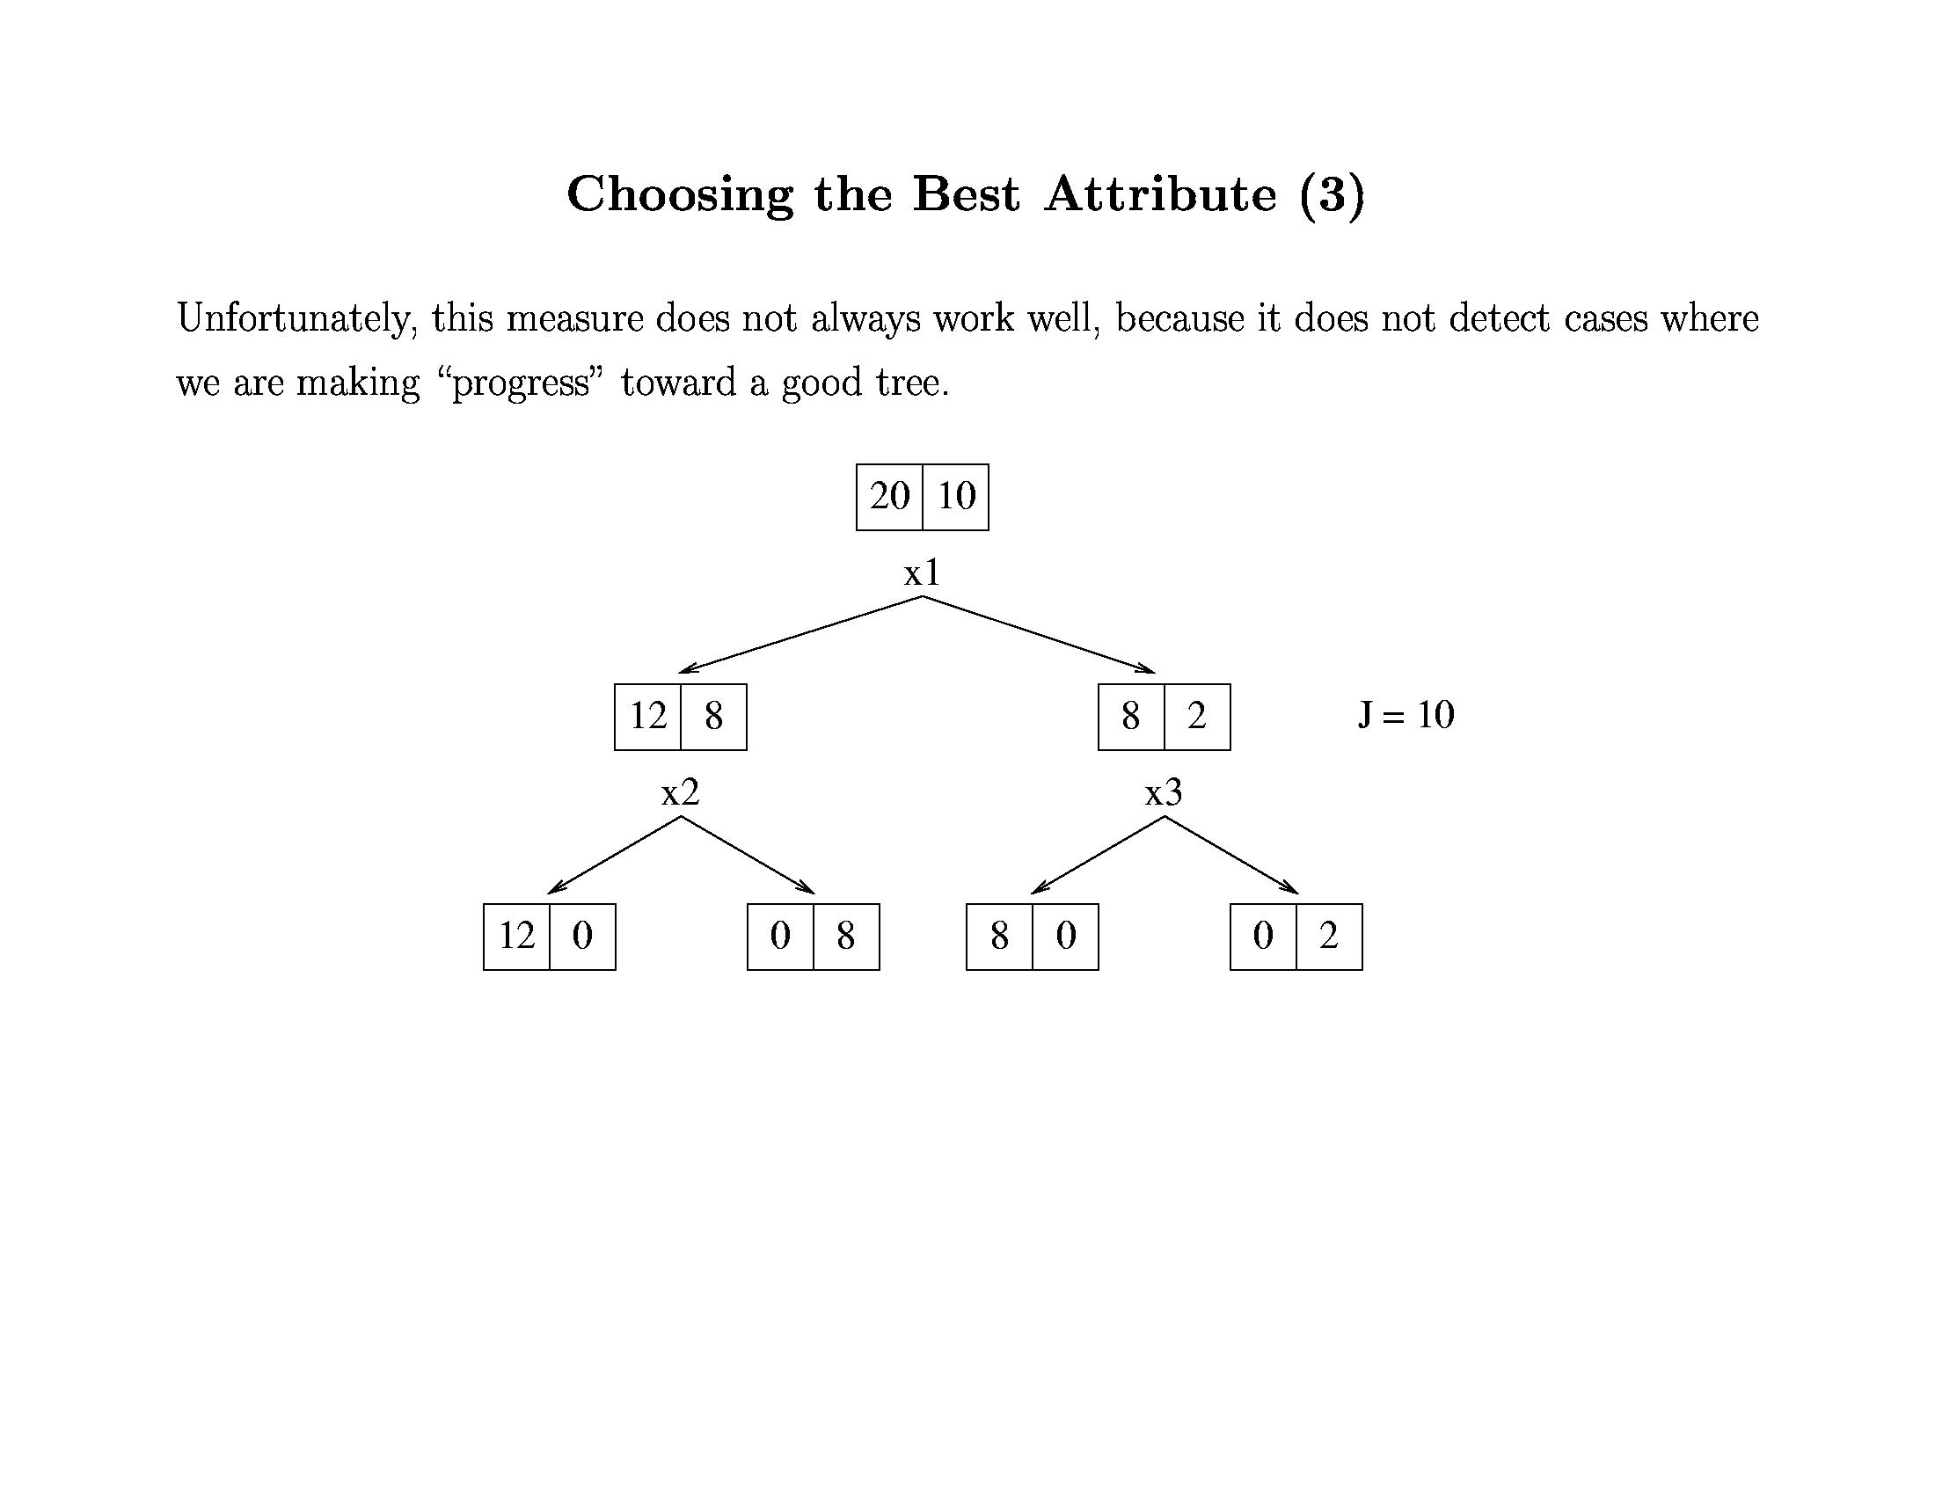
Decision Trees

Slide 12
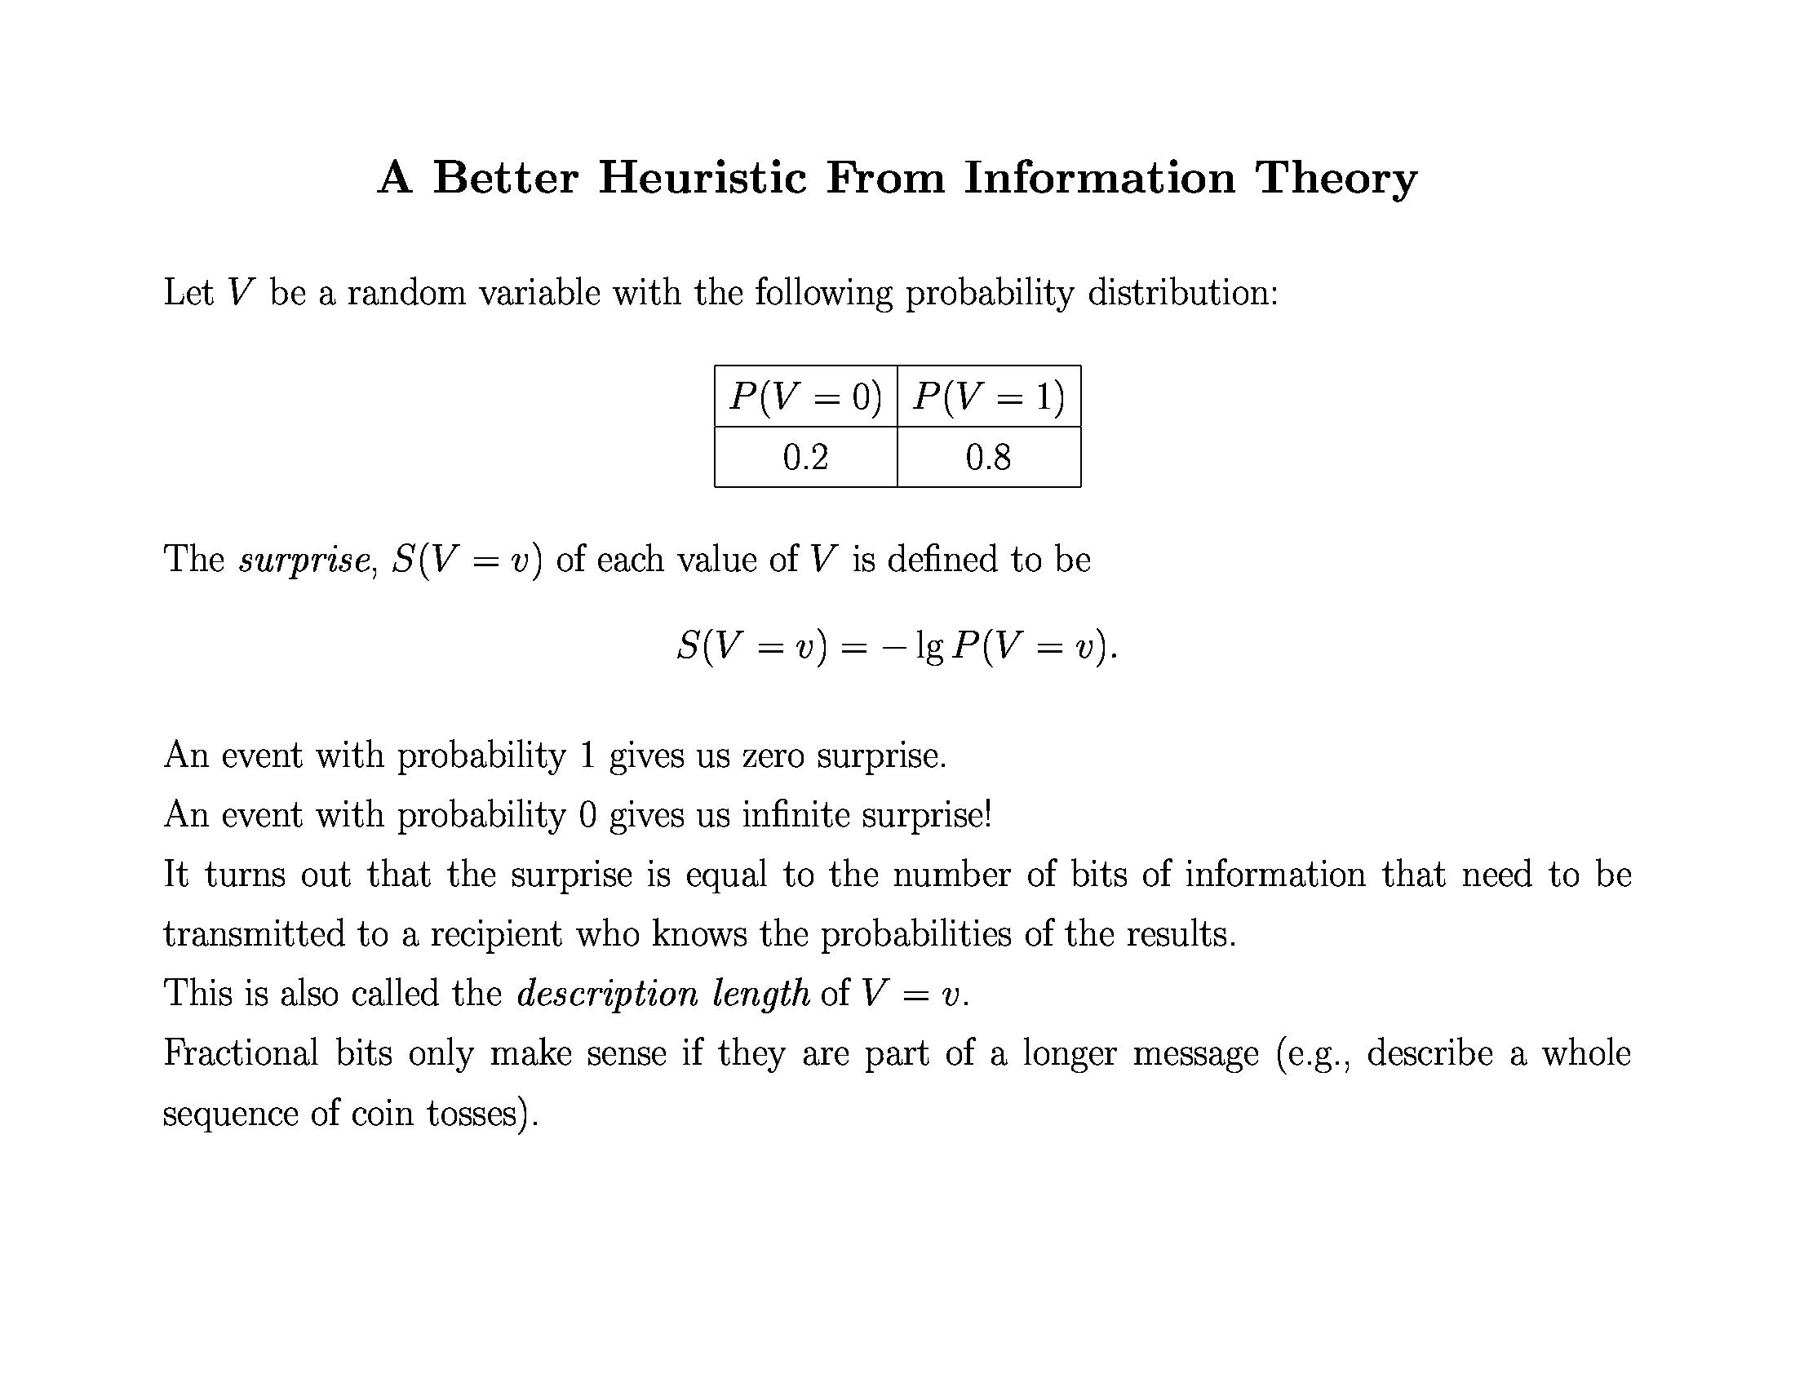
Decision Trees

Slide 13
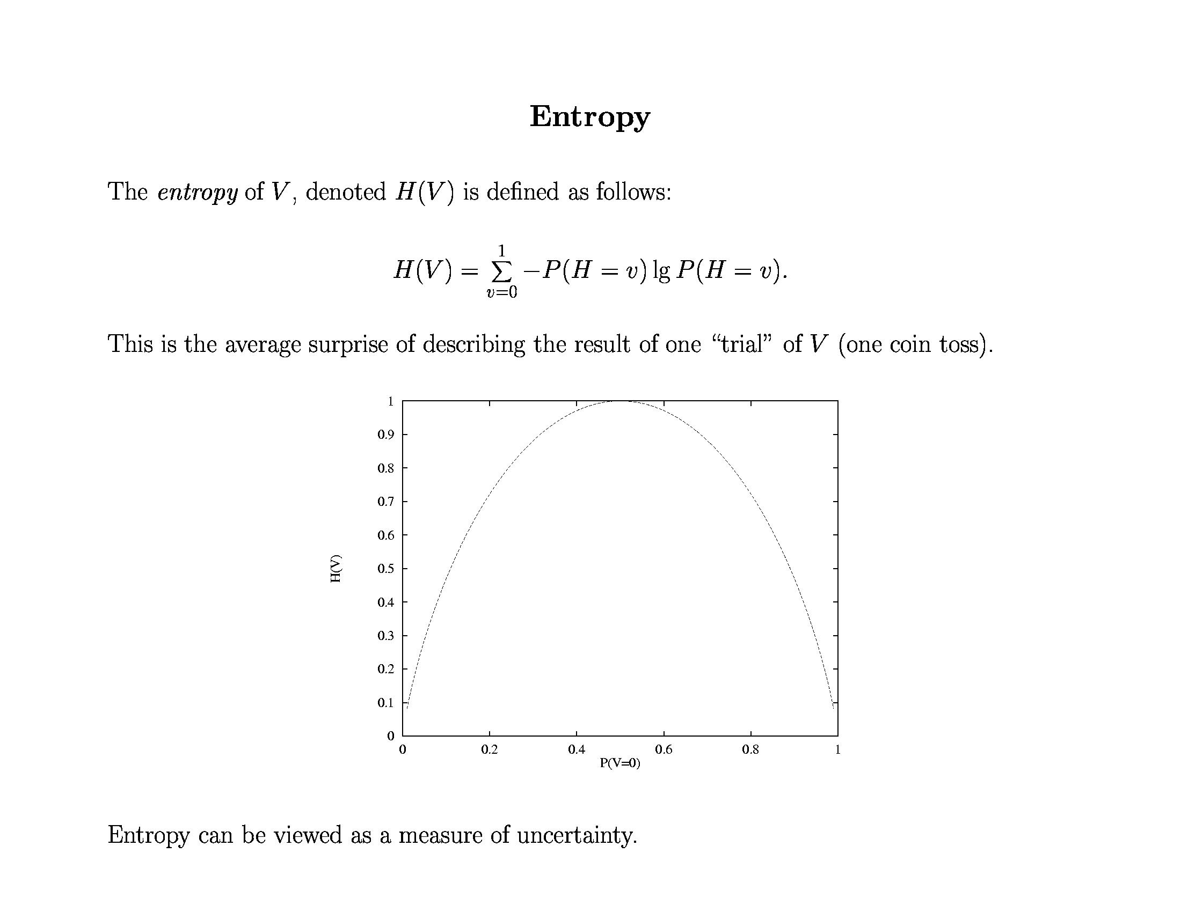
Decision Trees

Slide 14
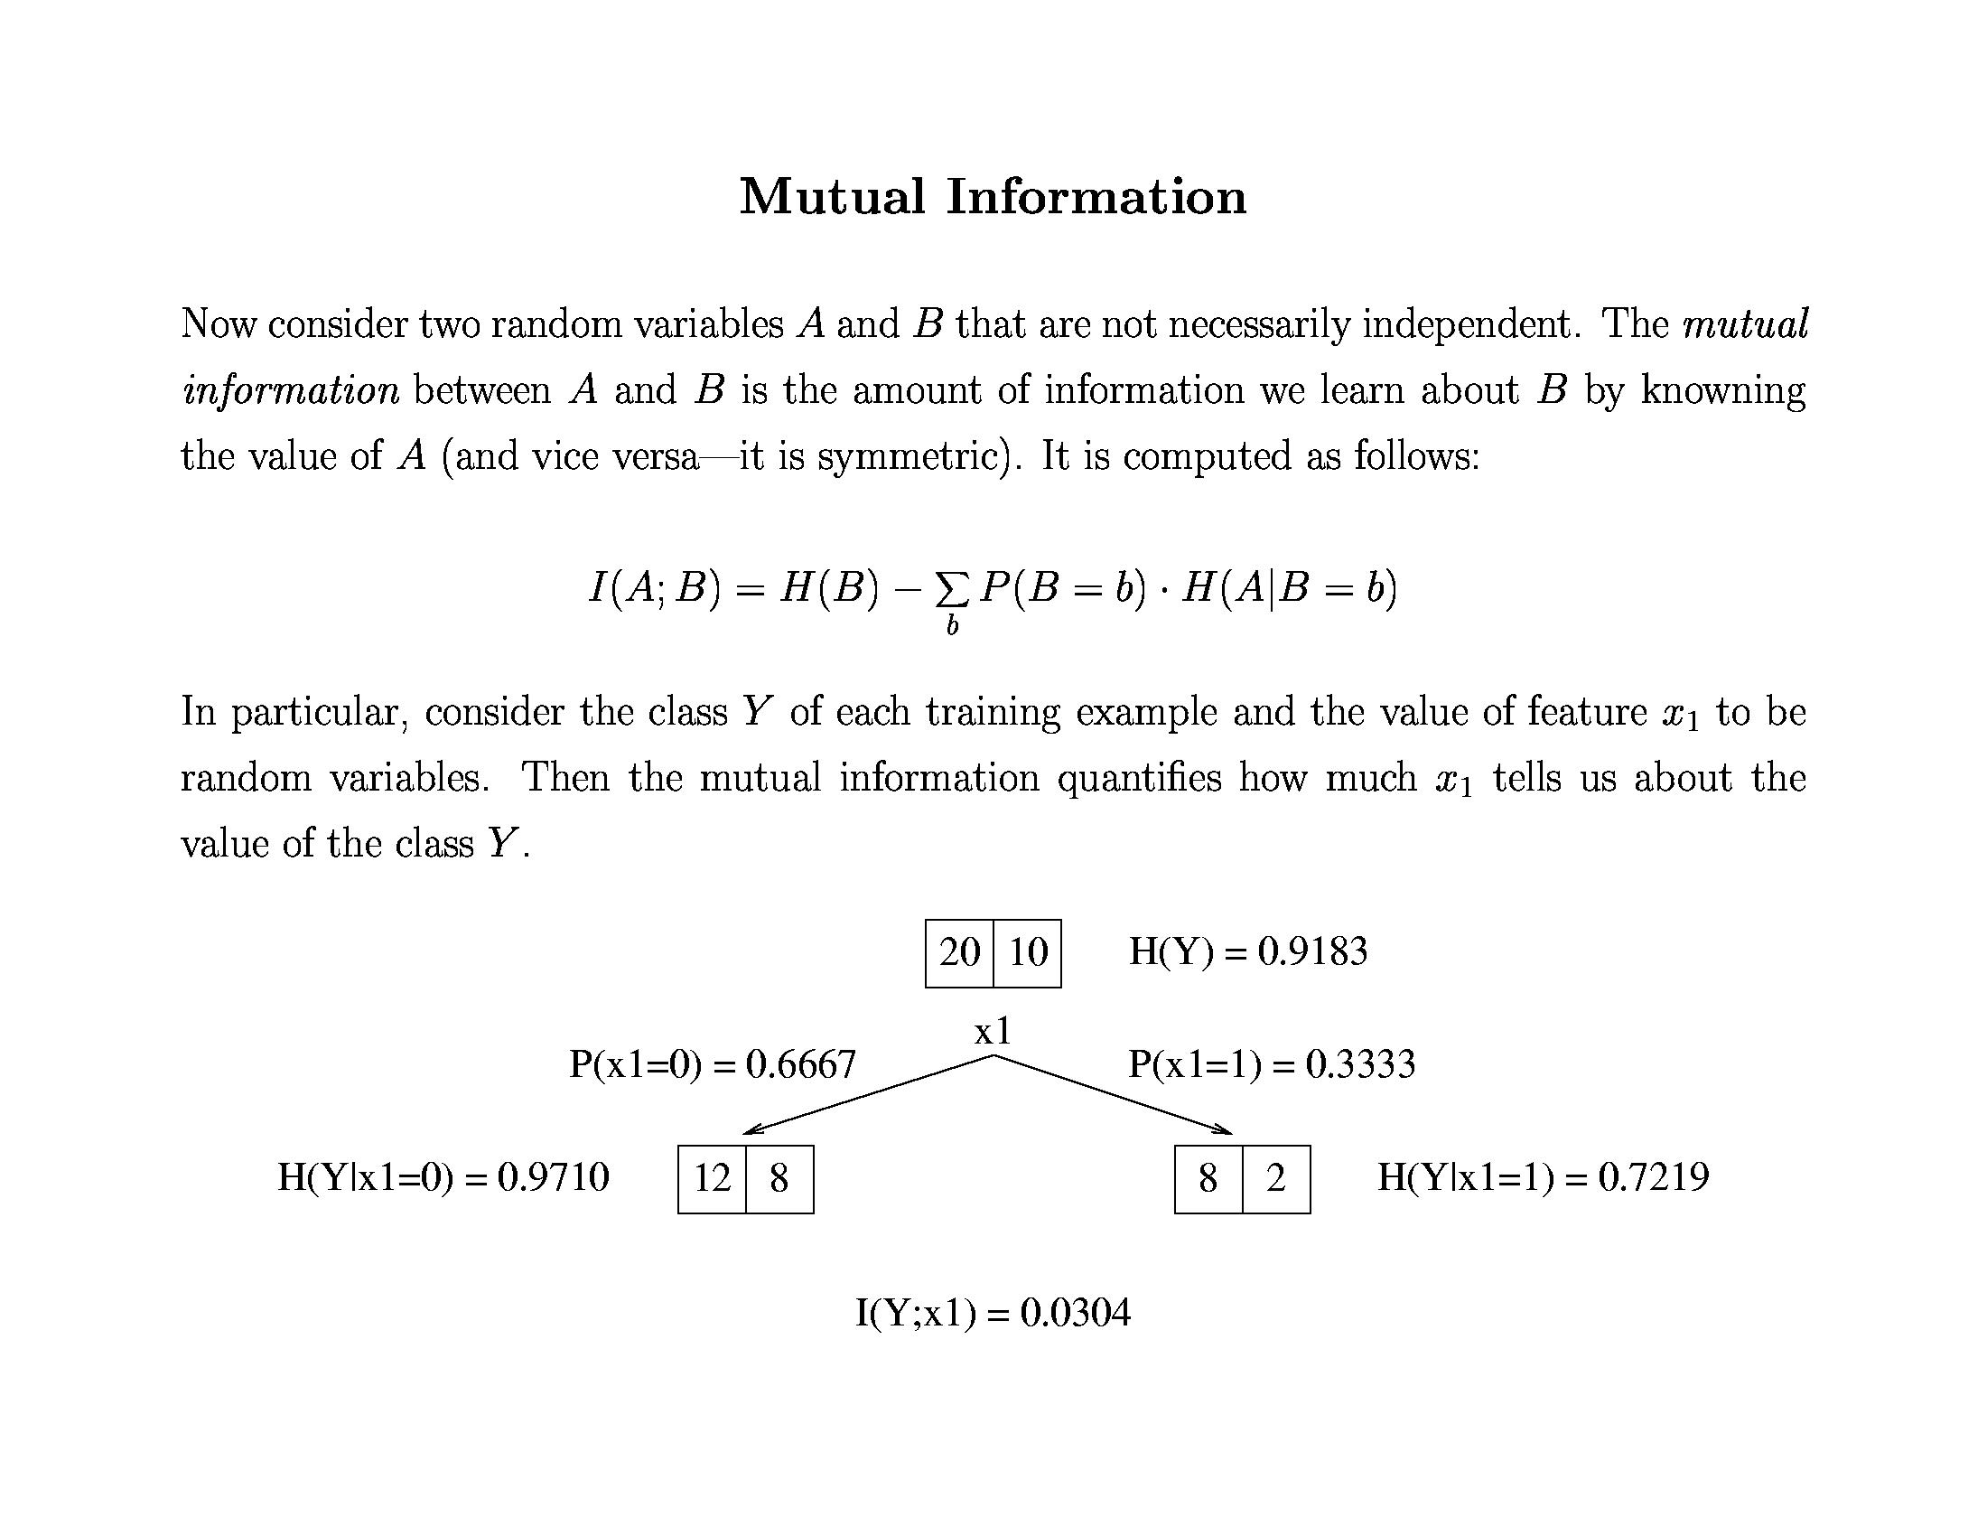
Decision Trees

Slide 15
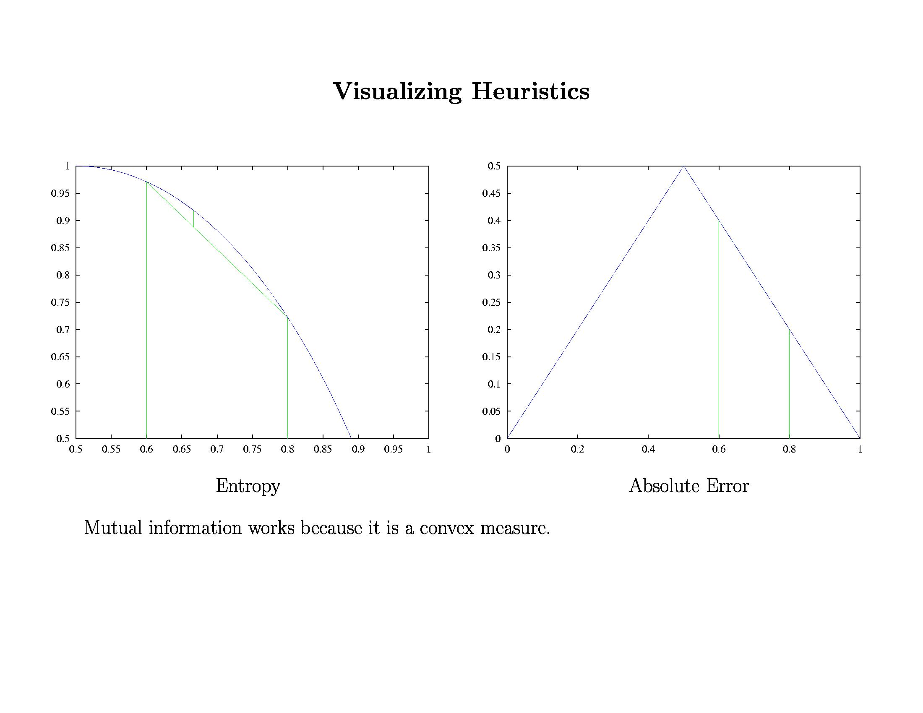
Decision Trees

Slide 16
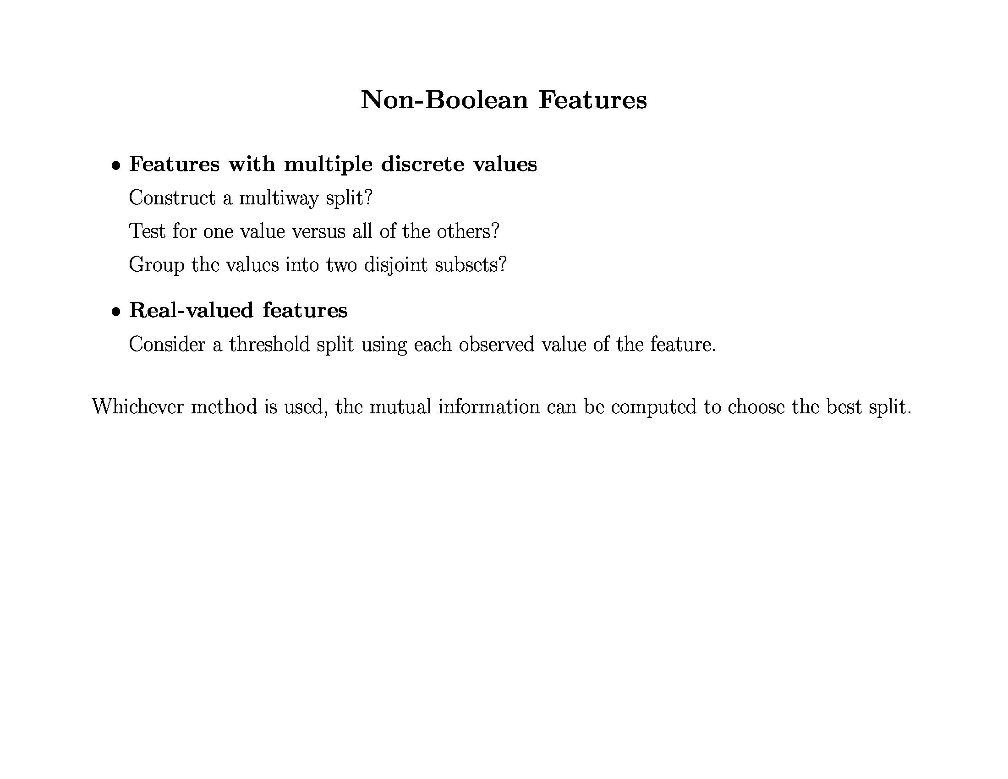
Decision Trees

Slide 17
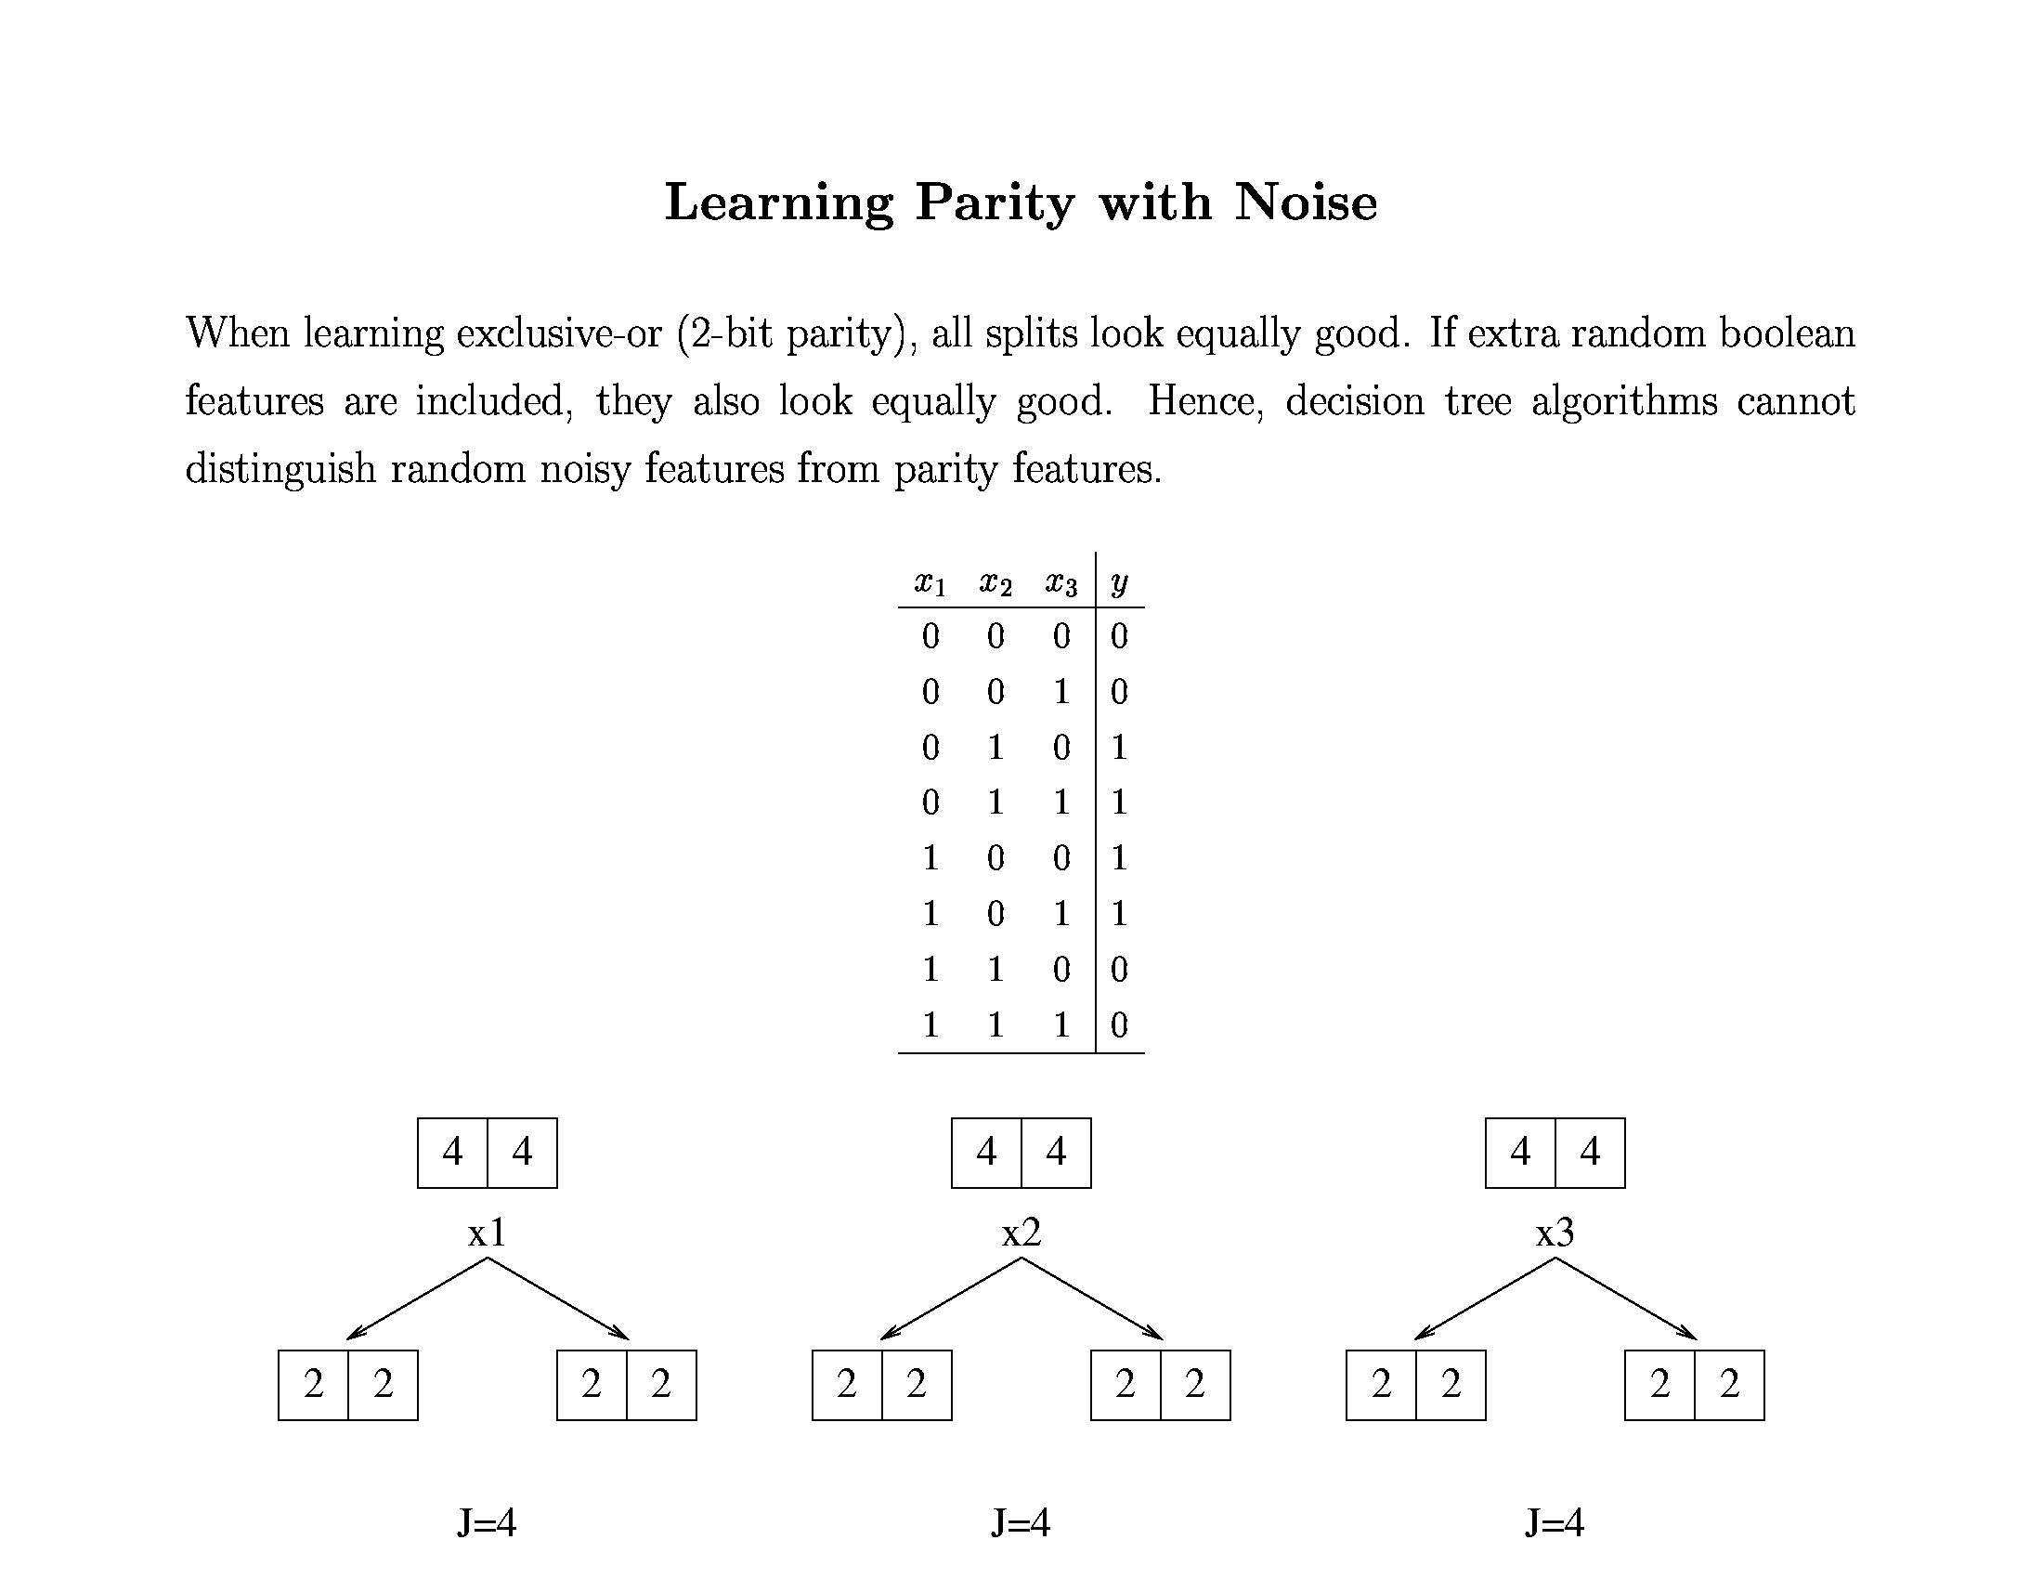
Decision Trees

Slide 18
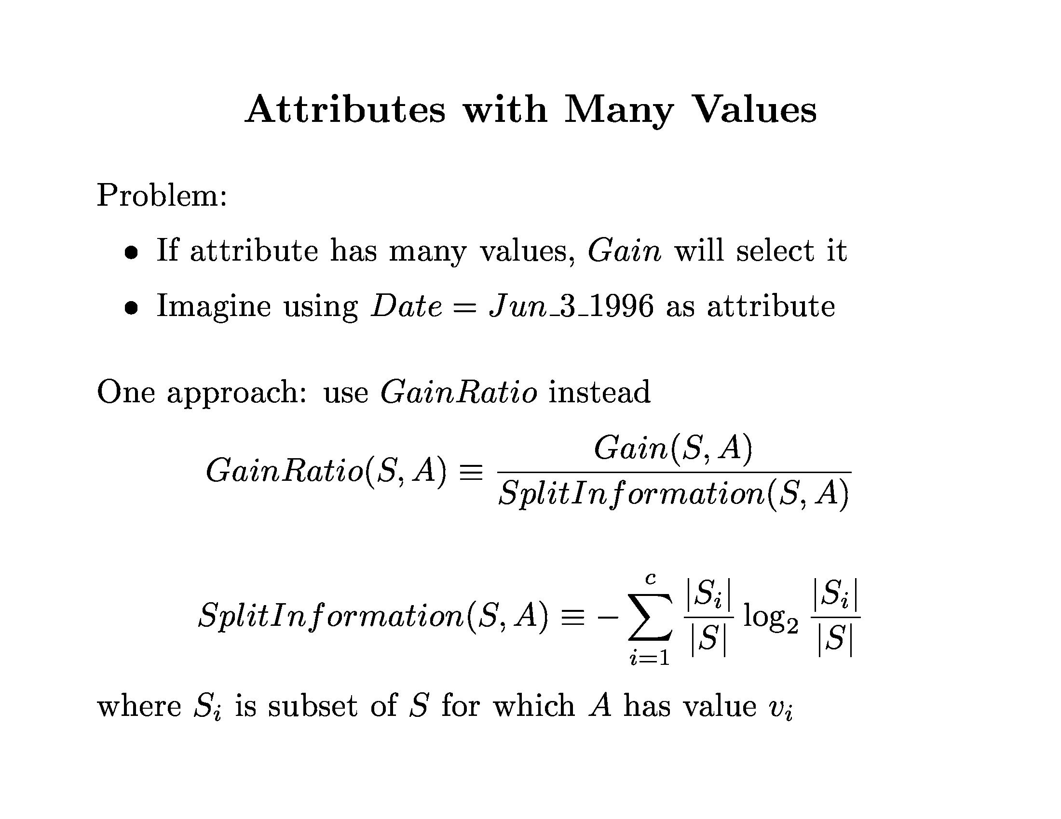
Decision Trees

Slide 19
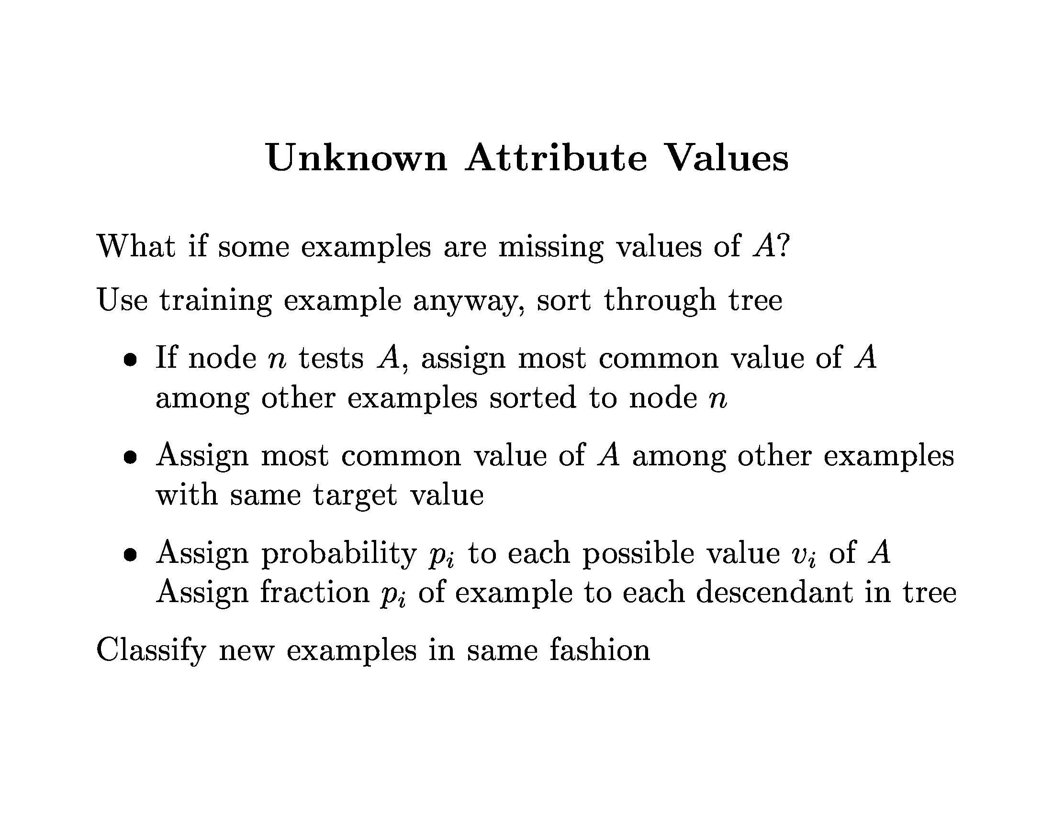
Decision Trees

Slide 20
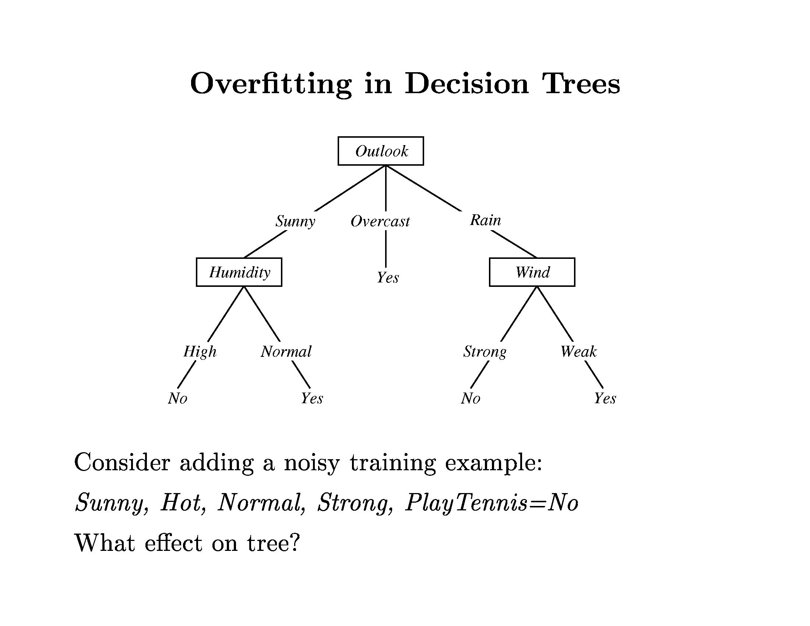
Decision Trees

Slide 21
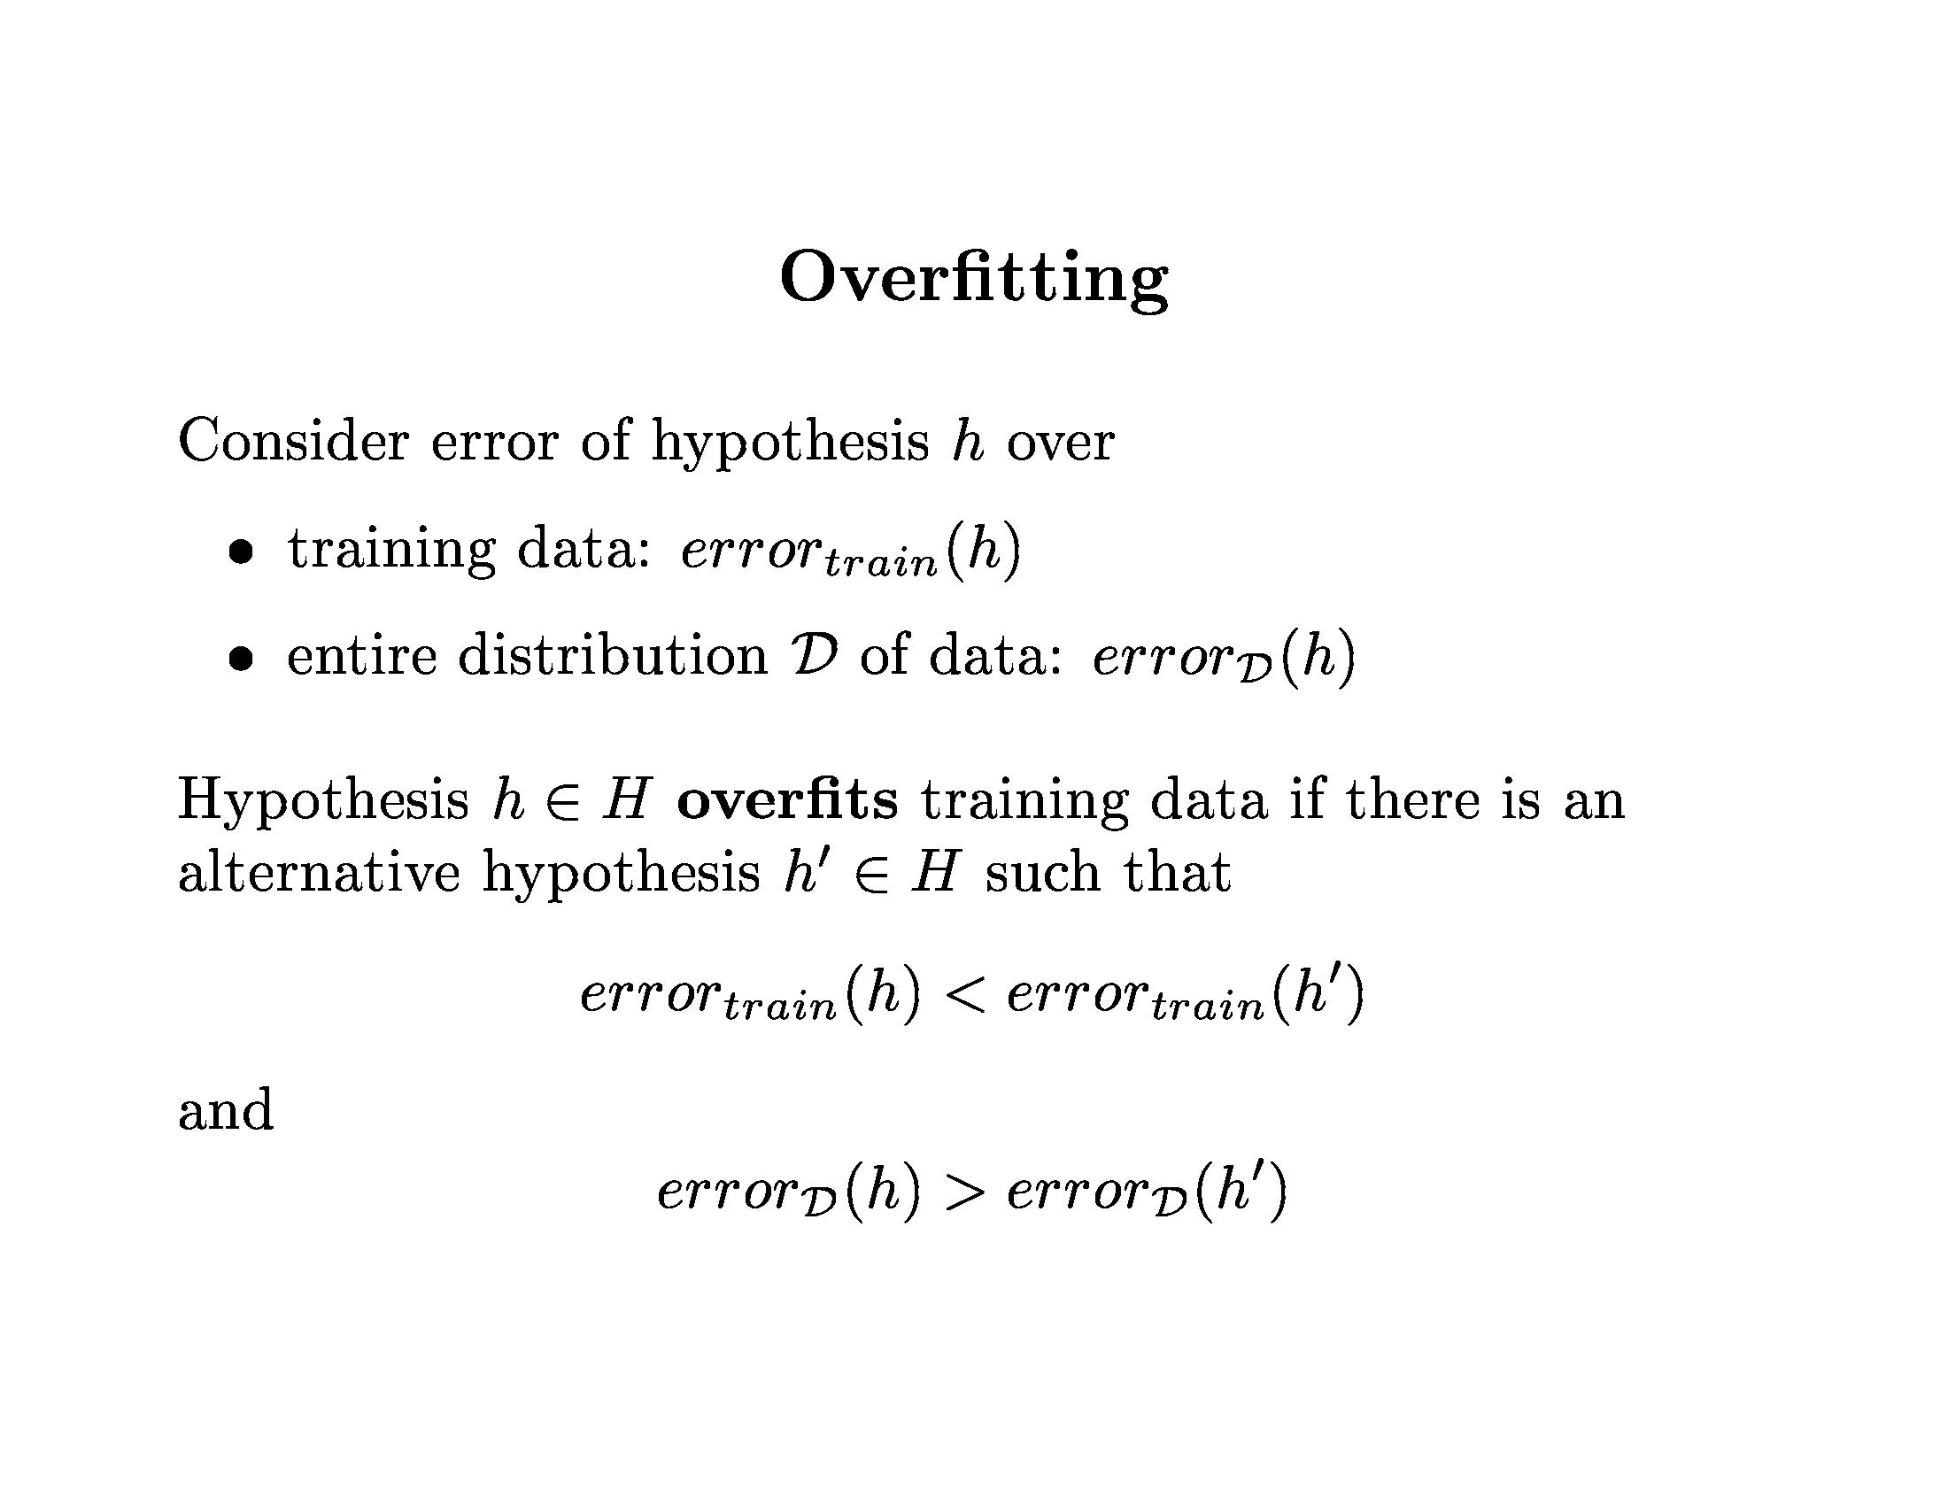
Decision Trees

Slide 22
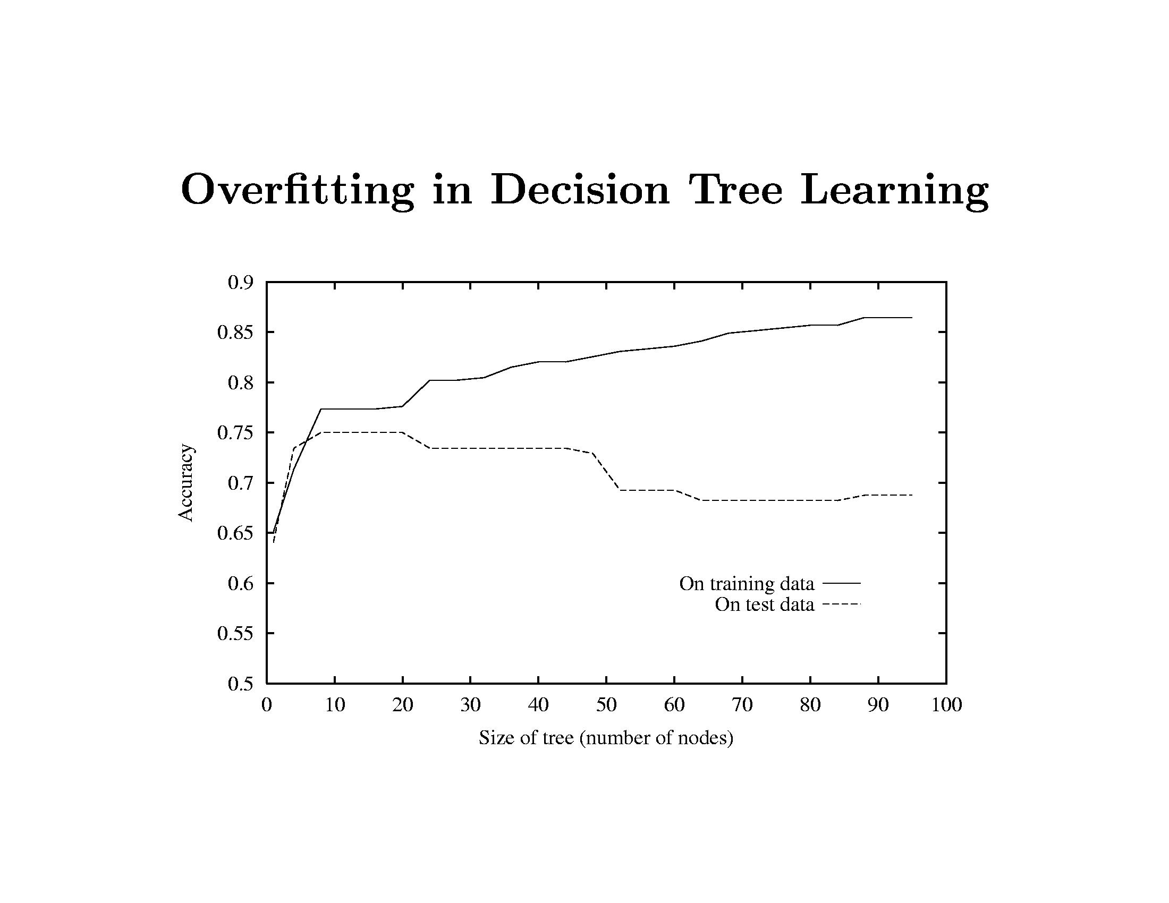
Decision Trees

Slide 23
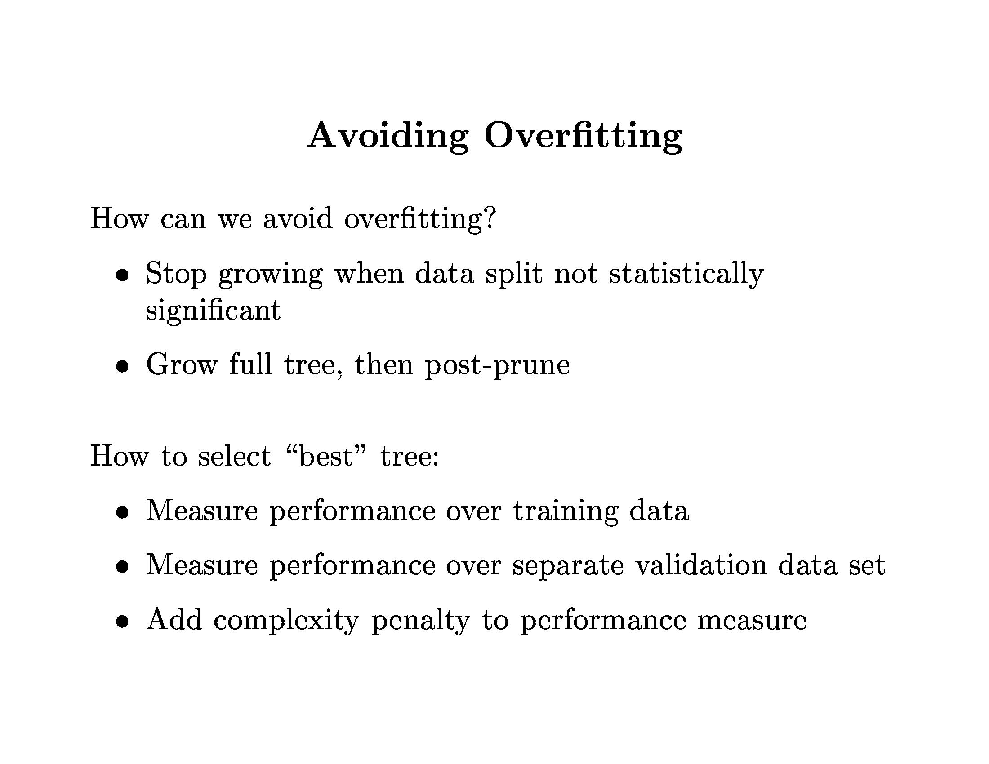
Decision Trees

Slide 24
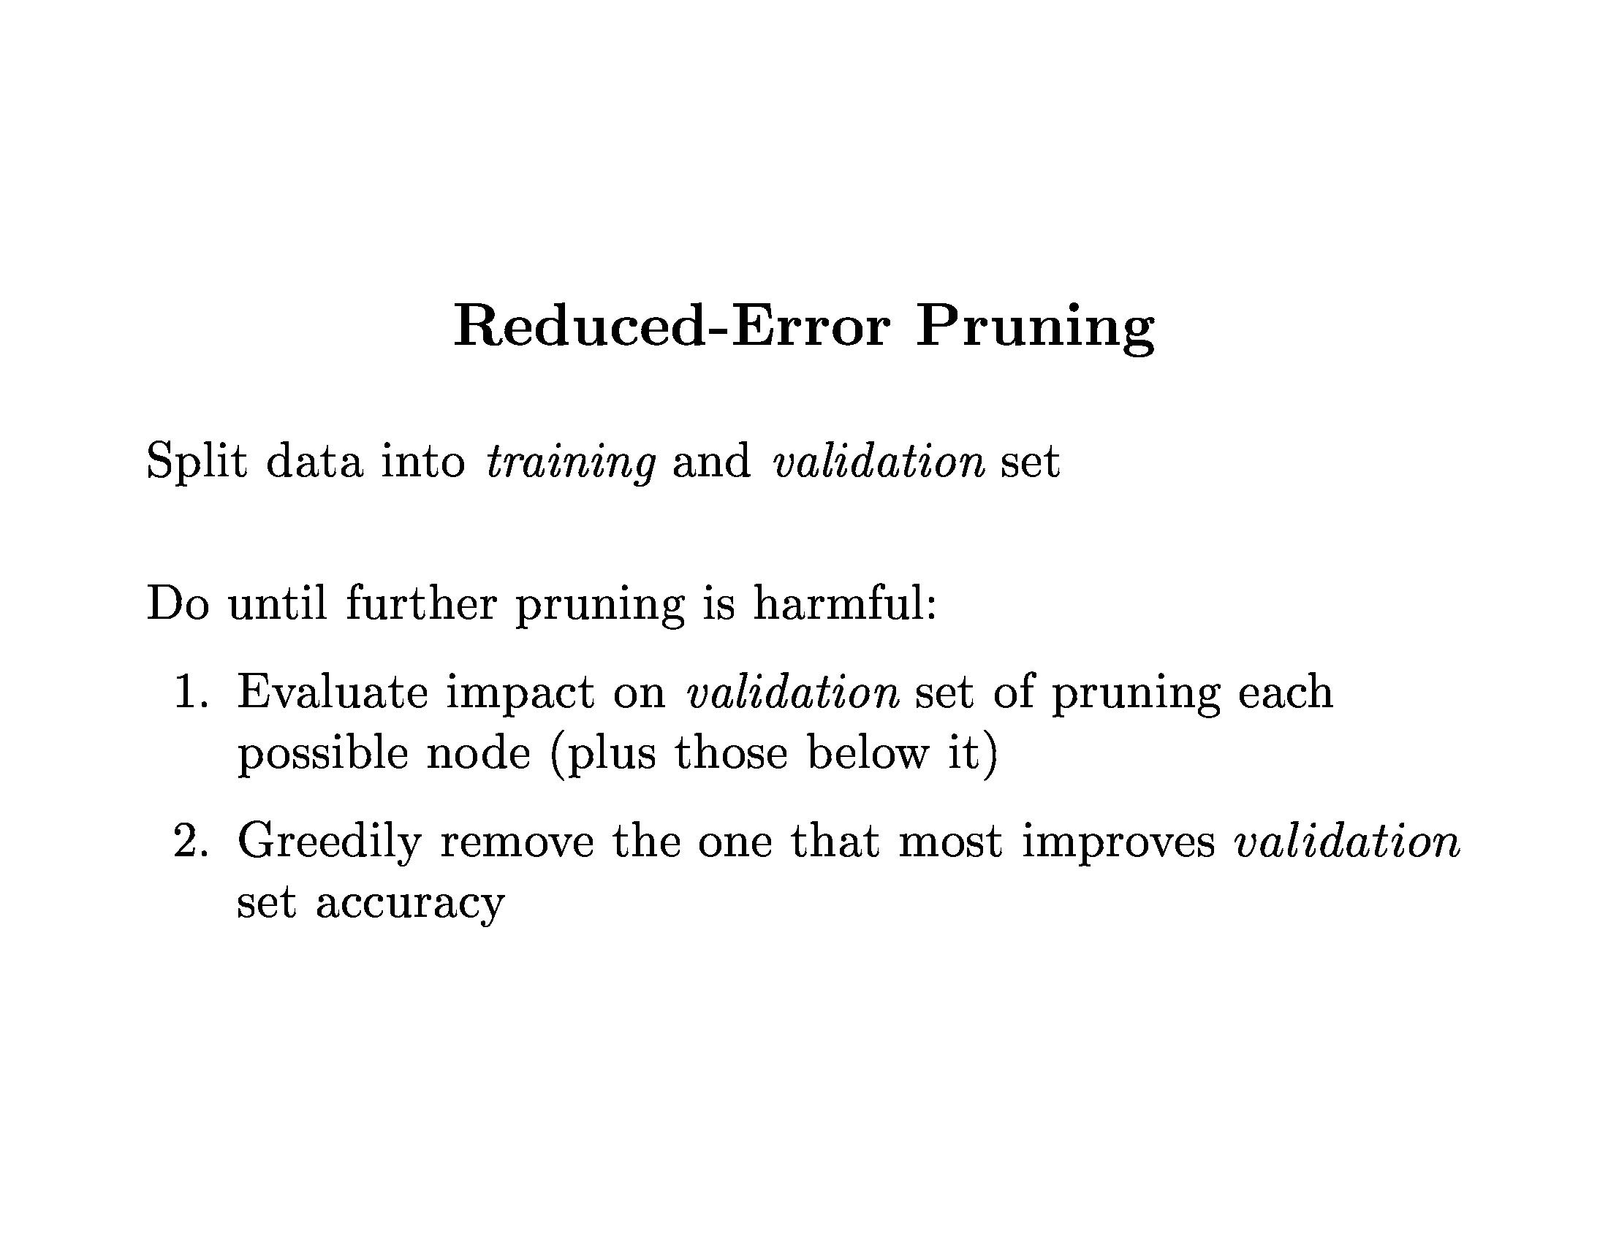
Decision Trees

Slide 25
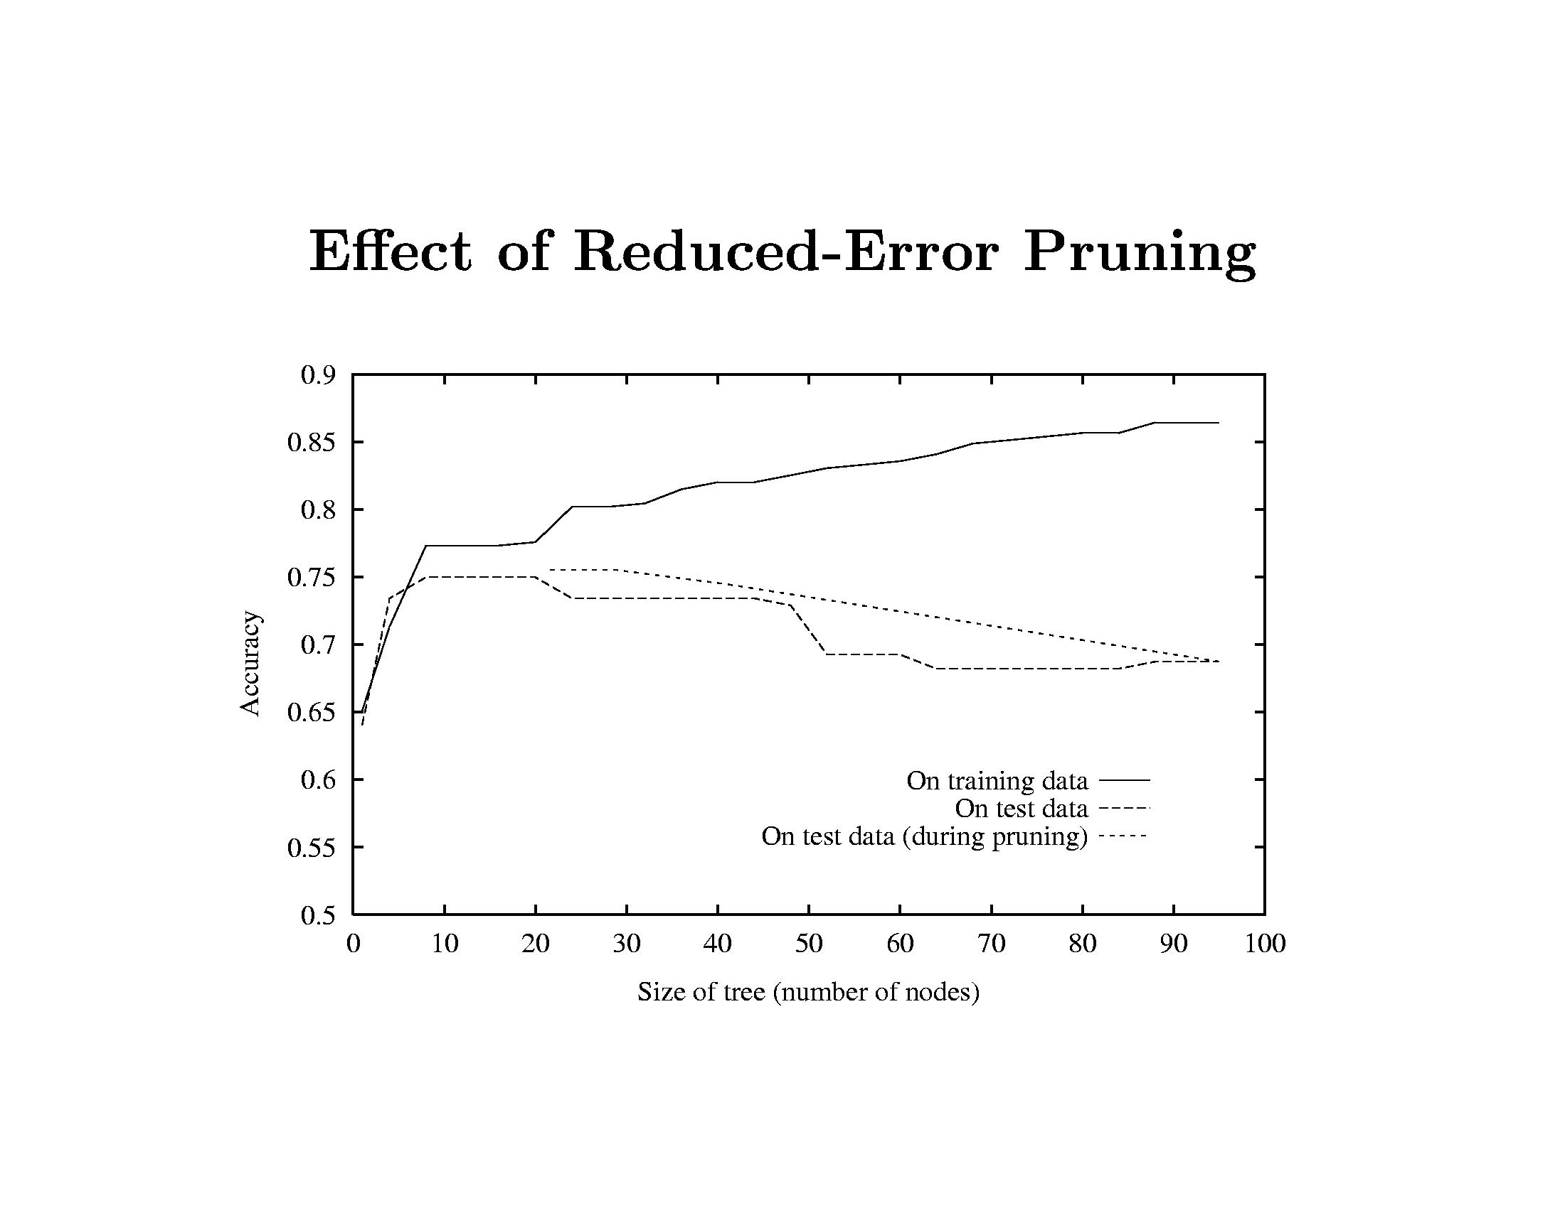
Decision Trees

Slide 26
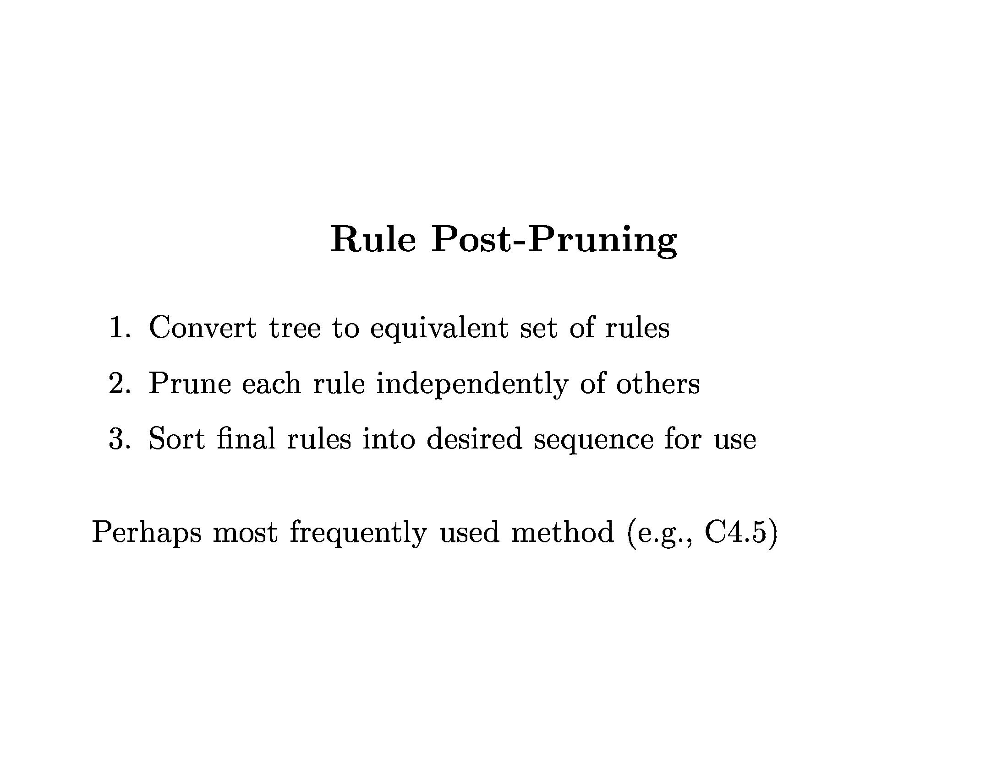
Decision Trees

Slide 27
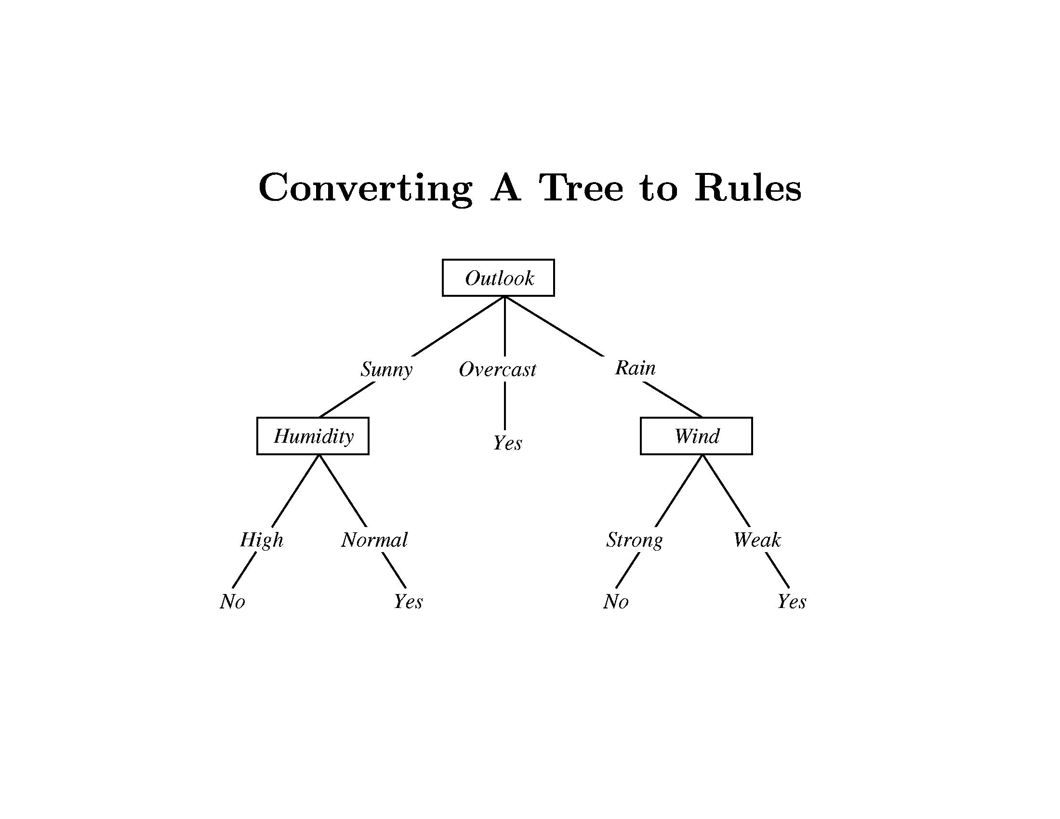
Decision Trees

Slide 28
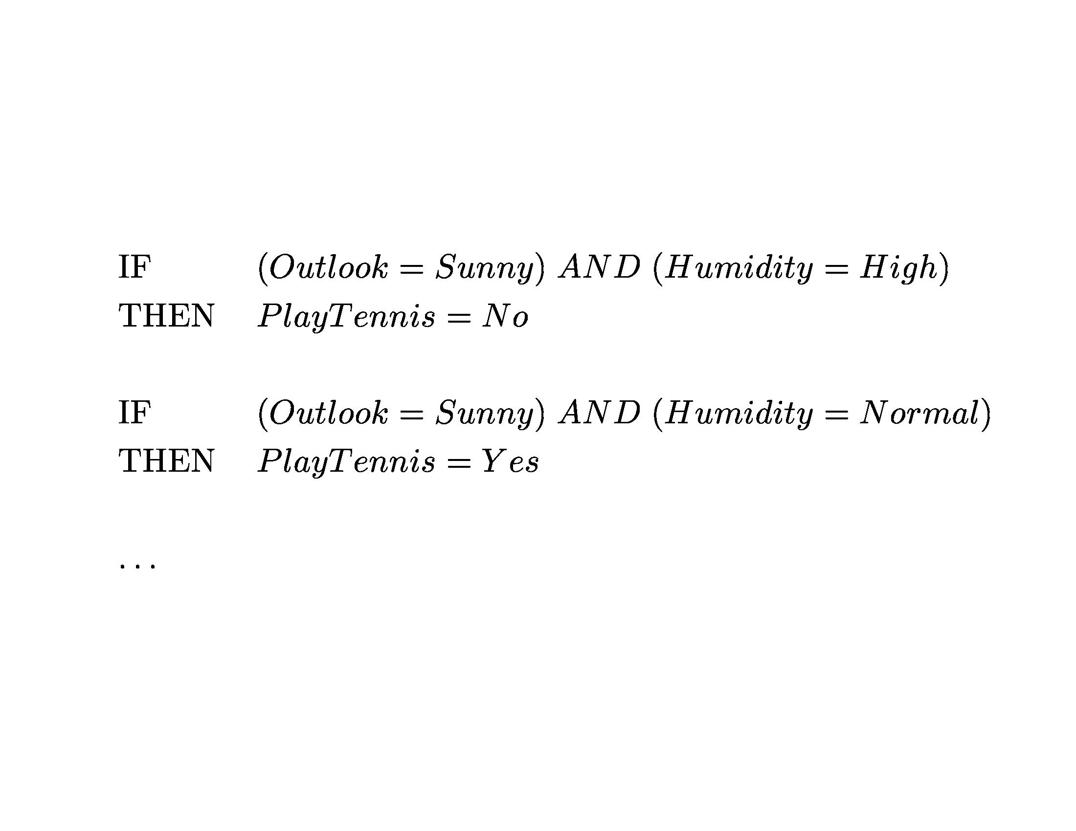
Decision Trees

Slide 29
Decision Trees
Summary
Representation
Tree growth
Heuristics
Overfitting and pruning

Slide 30
Decision Trees
Exercise: Decision Trees and Random Forest in Python

